Slide 1
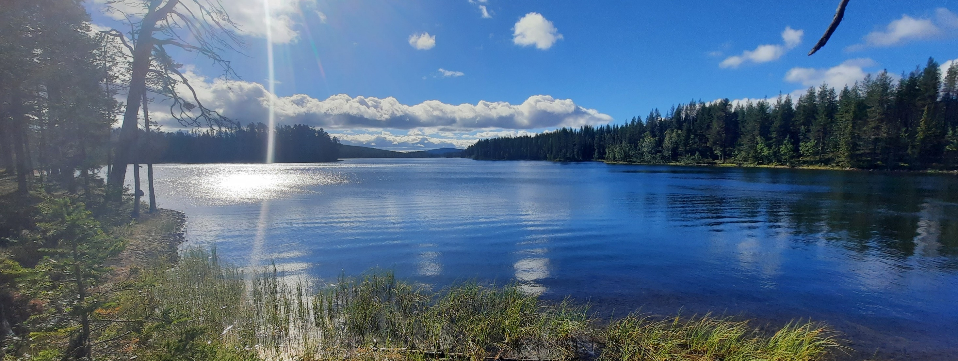
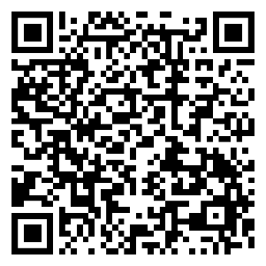
12th International Symposium on Ecosystem Biogeochemistry
BIOGEOMON
June 8-11 2026
Ecosystems in Transition
Umeå, Sweden
For more information
Check out our website: www.slu.se/biogeomon2026
Send us an email: Biogeomon2026@slu.se
Sign-up to our mailing list!

