Slide 1
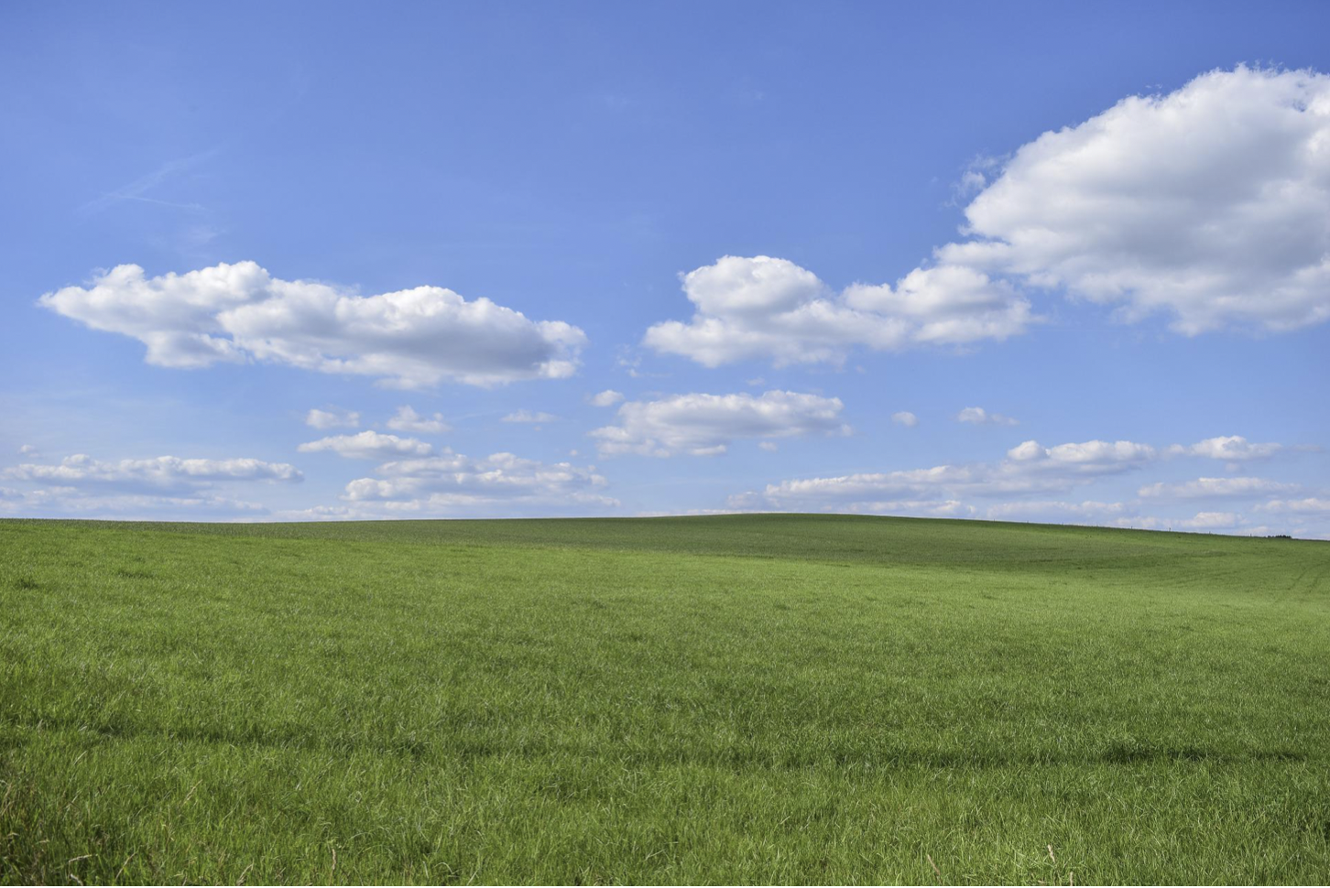
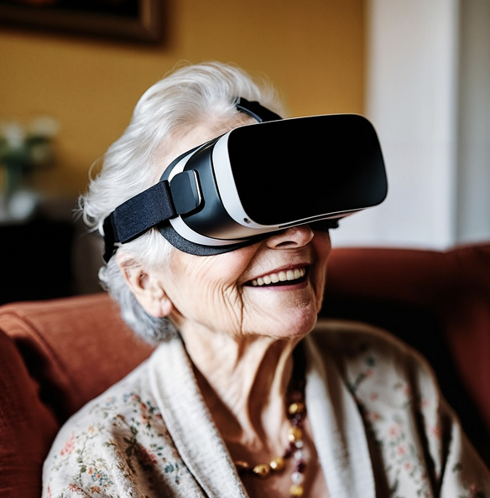


Virtual nature interventions at Palliative Medicine in Västerbotten
Catharina Norberg, Kristina Lämås &
Lisbeth Slunga Järvholm, Umeå University
in collaboration with
Palliative Medicine in Umeå, Skellefteå
and Axlagården Hospice

Slide 2

NATUREACH – Palliative care, WP 3.3
Aim To explore experiences and effects of using immersive virtual nature environments in patients and their relatives in a palliative care context.
Specific objectives Will virtual nature environments impact
Patients’ experiences of well-being?
Close relatives’ experiences of the situation and their state of mind?
The staff’s experience of mental stress, recovery and energy?
Notes:
Alltså kan VR-natur vara en komplementär metod vid palliativ vård?

Slide 3
NATUREACH – Palliative care, WP 3.3
Aim To explore experiences and effects of using immersive virtual nature environments in patients and their relatives in a palliative care context.
Specific objectives, will virtual nature environments impact
Patients’ experiences of well-being?
Close relatives’ experiences of the situation and their state of mind?
The staff’s experience of mental stress, recovery and energy?
Notes:
Alltså kan VR-natur vara en komplementär metod vid palliativ vård?

Slide 4

Intervention patients & close relatives
PATIENT
Rating of symptoms (NRS) before and after VR nature
pain
anxiety
nausea
breathlessness
CLOSE RELATIVE
Rating of mood
Afterwards individual semi-structured interviews of patients and relatives
VR nature sessions at three occasions in connection with home visits by the nurse in charge.
Afterwards possibility to borrow the equipment for two weeks to continue with VR nature on their own.
Notes:
Hur går det till?
Både patienter och närstående tillfrågas om att delta i en individuell semistrukturerad intervju.

Slide 5
Characteristics of patients and close relatives
 | Patients, n=7 | Close relatives, n=4
Sex, women/men | 2/5 | 4/0
Age, mean value (min, max) | 76 (68, 84) | 76 (69, 78)
Living with close relative, n | 6
Previous experience of IVR, n | 0 | 0
Disease, n Cancer Lung disorder Cardiovascular disease | 4 3 2
Qualitative interview, n | 5 | 4

Slide 6
Symptoms in patients before and after virtual nature

Slide 7
Mood in relatives before and after virtual nature

Slide 8
Preliminary results from qualitative interviews of patients (n=5), and their close relatives (n=4)
THEME | SUBTHEME
Being in a place where tranquillity becomes possible | Being released from emotional struggle
 | Being released from bodily suffering
 | Being in another world
 | Feeling unease when nothing happens
Connecting to nature via past experiences | Reliving past experiences
 | Grieving lost opportunity
 | Feeling at home
Perceiving nature sounds as important | Being moved by nature sounds
 | Natural sounds capture attention in a tranquil environment
 | Limited audibility makes experience weak or almost absent
Perceiving nature in IVR as a supplement | Complement rather than replacement

Slide 9
Summary
Many patients in palliative home care were too fragile to be suitable for the study.
The equipment worked well for both patients and relatives.
A tendency towards less symptoms of anxiety and breathlessness in patients.
A tendency towards more beneficial mood ratings in relatives.
Qualitative interviews
- mostly positive experiences, but also some concerns about the environments and evoked feelings,
- patient and relative could revive memories, and at times also share them with each other,
- if possible, patient and relative prefer IRL nature, but IVR is a good complement.

Slide 10
Exit plan
We support Palliative medicine in Umeå and Skellefteå to implement IVR nature as a regular complementary method in palliative home care.
We have also had some cooperation and dialogue with the hospice Axlagården in Umeå.
Thank You!

