Slide 1
Randomized block trials with spatial correlation
Workshop in Mixed Models
Umeå, August 27-28, 2015
Johannes Forkman, Field Research Unit, SLU

Slide 2
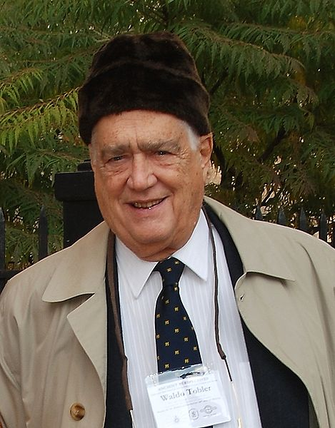
Tobler’s first law of geography
”Everything is related to everything else, but near things are more related than distant things”
Tobler (1970)

Slide 3
Example
Field experiment
28 plots in a single row
Seven fertilization treatments (A-G)
Four blocks
1 | 2 | 3 | 4 | 5 | 6 | 7 | 8 | 9 | 10 | 11 | 12 | 13 | 14 | 15 | 16 | 17 | 18 | 19 | 20 | 21 | 22 | 23 | 24 | 25 | 26 | 27 | 28
C | A | G | D | E | F | B | G | E | B | C | A | F | D | B | A | G | E | D | F | C | E | A | C | F | G | B | D
Example provided by Anders Ericsson,
Swedish Rural Economy and Agricultural Societies, HS Konsult

Slide 4
Randomized complete block model
Yield = Treatment + Block + Error
Fixed effects of Treatment
Random effects of Block and Error
Errors are normally distributed and independent

Slide 5
Randomized compete block analysis
 | Degrees of freedom
 | Num | Den. | F | P
Treatment | 6 | 21 | 1,18 | 0,352
The block variance was estimated to 0

Slide 7
Model with spatial correlation
Yield = Treatment + Block + Error
Fixed effects of Treatment
Random effects of Block and Error
Errors are normally distributed and correlated

Slide 8
Analysis using SAS
proc mixed data = HC0811 ;
class Block Treatment ;
model Yield = Treatment / ddfm = sat ;
random Block ;
repeated / type = sp(sph)(Plot) subject = intercept ;
lsmeans Treatment / pdiff adjust = Tukey adjdfe = row ;
run ;
Gaussian: sp(gau)
Spherical: sp(sph)
Exponential: sp(exp),
Notes:
Notera att subject är intercept, eftersom alla obs ligger på en rad.

Slide 9
Analysis using R
library(nlme)
Model <- lme(Yield ~ Treatment, random = ~ 1 | Block,
na.action = na.exclude, data = HC0811,
corr = corSpher(form = ~ Plot))
summary(Model)
anova(Model)
library(multcomp)
summary(glht(Model, linfct = mcp(Led = "Tukey")))
Gaussian: corGaus
Spherical: corSpher
Exponential: corExp,
Notes:
The two programs rarely gives the same results

Slide 11
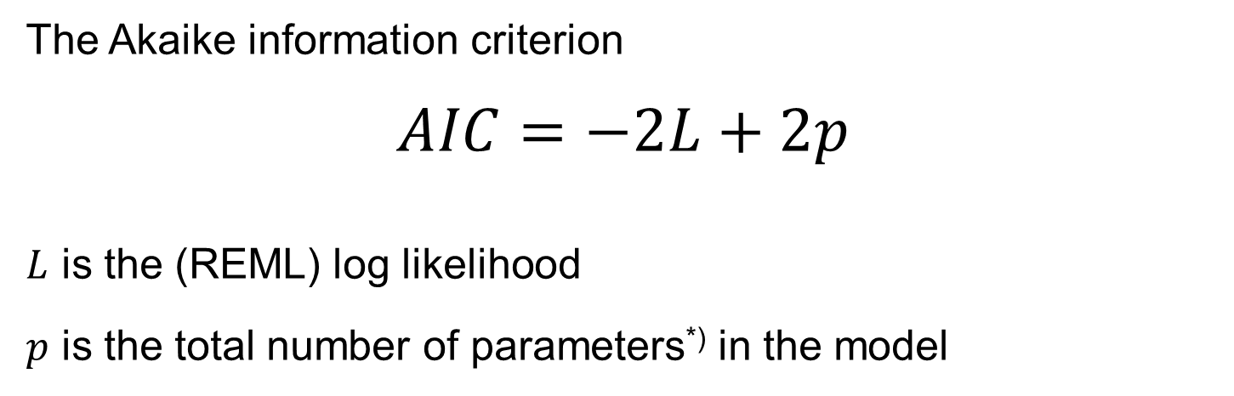
How to choose correlation function?
The Akaike information criterion
$$AIC=−2L+2p$$
$L$ is the (REML) log likelihood
$p$ is the total number of parameters^{*)} in the model
AIC should be as small as possible!
*) In SAS, $p$ is the total number of variances and covariances
In R, $p$ is the total number of fixed parameters, variances and covariances
Notes:
In SAS, the parameters are the variances and the covariances

Slide 12

This is the one with the smallest AIC
Correlation function | AIC
No correlation | 347.8
Gaussian | 337.3
Exponential | 337.1
Spherical | 336.6

Slide 13
Analysis using the spherical correlation function
 | Degrees of freedom
 | Num. | Den. | F | P
Treatment | 6 | 20.9 | 2.80 | 0,037
Analysis using the mixed procedure, SAS (Satterthwaite’s method)
AIC = 336.6
The block variance was estimated to 0

Slide 14

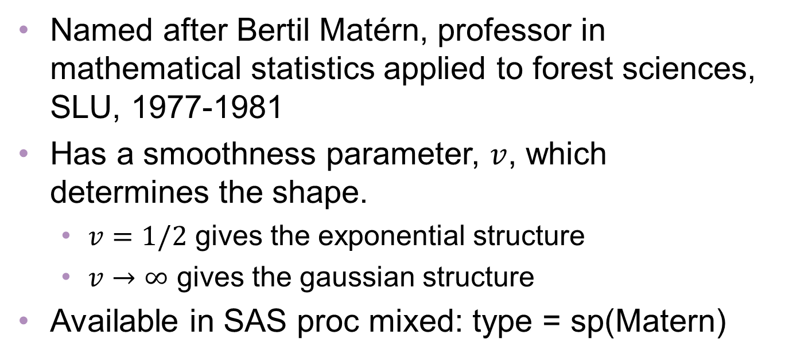
Matérn correlation function
Named after Bertil Matérn, professor in mathematical statistics applied to forest sciences, SLU, 1977-1981
Has a smoothness parameter, $v$, which determines the shape.
  $v=1/2$ gives the exponential structure
  $v→∞$ gives the gaussian structure
Available in SAS proc mixed: type = sp(Matern)
Notes:
Bertil Matérn levde 1917-2007.

Slide 15

Analysis using the Matérn correlation function
 | Degrees of freedom
 | Num. | Den. | F | P
Treatment | 6 | 8.1 | 5.94 | 0,012
Analysis using the mixed procedure, SAS (Satterthwaite’s method)
AIC = 334.5
The block variance was estimated to 0

Slide 16

One dimension
1 | 2 | 3 | 4 | 5 | 6 | 7 | 8 | 9 | 10 | 11 | 12 | 13 | 14 | 15 | 16 | 17 | 18 | 19 | 20 | 21 | 22 | 23 | 24 | 25 | 26 | 27 | 28
C | A | G | D | E | F | B | G | E | B | C | A | F | D | B | A | G | E | D | F | C | E | A | C | F | G | B | D
Plot
SAS: sp(sph)(Plot)
R: corSpher(form = ~ Plot)
Two dimensions
Column
5
4
3
2
1
1 | 2 | 3 | 4 | 5 | 6 | 7 | 8 | 9 | 10 | 11 | 12 | 13 | 14 | 15 | 16 | 17 | 18 | 19 | 20 | 21 | 22 | 23 | 24 | 25 | 26 | 27 | 28
Row
SAS: sp(sph)(Row Column)
R: corSpher(form = ~ Row + Column)

Slide 17

Message
In mixed models, errors need not be independent
The analysis can be improved by modeling spatial correlation

