Slide 1
An introduction to General Additive Models
Claudia von Brömssen
Dept. of Energy and Technology

Slide 2
Why use General Additive Models (GAMs)?
A linear regression fit

Slide 3
Why use General Additive Models (GAMs)?
An additive model fit

Slide 4
Why use General Additive Models (GAMs)?
Using GAMs we relax the assumption of linearity between predictors and response variable.
We could do this also with a general linear model (GLM) using a quadratic or cubic fit or with a nonlinear regression model.
quadratic fit
cubic fit

Slide 5
Why use General Additive Models (GAMs)?
we do not need to determine the functional form of the relationship in beforehand
if relationships are best approximated by linear, quadratic or cubic function the result of GAM simplifies to that
we have most of the possibilities we have with GLMs, GLiMs, and GLMM, e.g. we can
    include categorical predictors and interactions and
    use other distributions than normal for the response
    use mixed approaches to include autocorrelation estimates or hierarchical sampling structures

Slide 6
So, how do I use GAMs anyway?
A couple of statistical softwares have some GAM functions available, but if you want to use all available features you need to choose R.
Package gam:
https://cran.r-project.org/web/packages/gam/index.html
Package mgcv:
https://cran.r-project.org/web/packages/mgcv/mgcv.pdf
Book:
Generalised Additive Models – An introduction with R, Simon Wood
The code I show you will be using mgcv:gamm.

Slide 7
So, how do I use GAMs anyway?
In SAS there is PROC GAM, but with much fewer choices.
You can also model smooth relationships between response and predictors within PROC GLIMMIX. Use the effect statement.

Slide 8
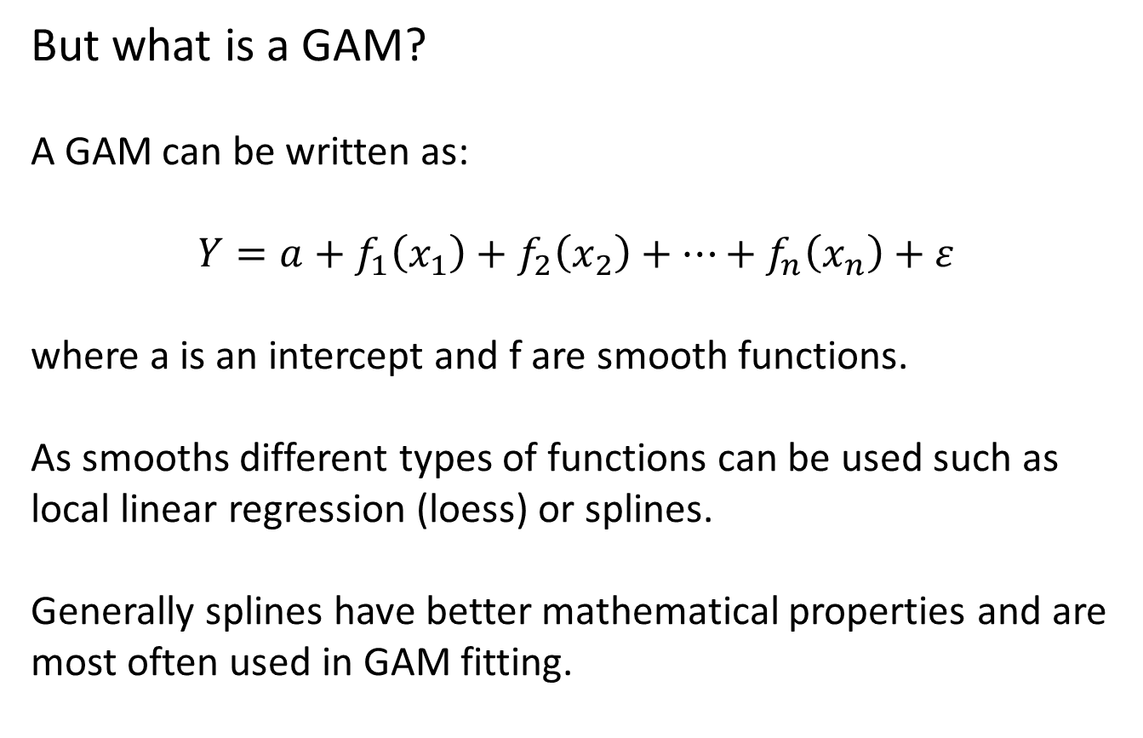
But what is a GAM?
A GAM can be written as:
$$Y=a+f_{1}\left(x_{1}\right)+f_{2}\left(x_{2}\right)+…+f_{n}\left(x_{n}\right)+ε$$
where a is an intercept and f are smooth functions.
As smooths different types of functions can be used such as local linear regression (loess) or splines.
Generally splines have better mathematical properties and are most often used in GAM fitting.

Slide 9
But what is a GAM?
Splines are sums of weighted basis functions.
The flexibility of the fit is determined by the amount of basis functions.
Depending on which type of spline is used the basis function look differently and have different properties.

Slide 10
And what are basis functions?
Basis functions of a cubic regression spline
Basis functions of a thin plate spline
Using knots Not using knots

Slide 11
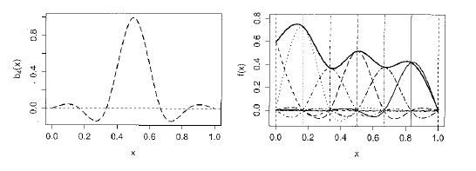
And what are basis functions?
Combining basis functions to create a smooth.
Figure 4.1. in Generalised Additive models – An introduction with R, Simon Wood, Chapman & Hall

Slide 12
But what is a GAM?
Even though basis functions can look very different from each other the final fit is often very similar:
Black curve: thin plate spline Red curve: cubic regression spline

Slide 13
Some versions of splines in the mgcv package:
Thin plate spline (tp):
- does not use knots
- can be used for multiple covariates (modelling interactions)
- computationally expensive
Cubic regression splines (cr):
- uses knots
- can only be used for single covariates
- computationally less expensive
Cyclic cubic regression splines (cc):
- as cr, but has the same start and end point, e.g. for modelling seasonality

Slide 14
Some versions of splines in the mgcv package:
Thin plate spline with shrinkage (ts):
- as tp, but allows the complete removal of covariates if they are not needed (variable selections)
Cubic regression splines with shrinkage (cs):
- as cr, but allows complete removal of covariates
Tensor products (te):
- another alternative if you have multiple covariates (= interactions), see later

Slide 15
GAM using mgcv:
Fit a model using time (datenr) as covariate to describe a temporal trend.
model_1c <- gamm(logTot.P~s(datenr, bs='tp'), data=river)
Default, a thin plate spline
model_1d <- gamm(logTot.P~s(datenr, bs='cr'), data=river)
A cubic regression spline
model_1e <- gamm(logTot.P~s(datenr, k=20), data=river)
Steer the complexity of the initial fit

Slide 16
GAM using mgcv:
Here k=5:

Slide 17
GAM using mgcv:
Here k=10:

Slide 18
Output and interpretation of GAMs:
model_1c <- gamm(logTot.P~s(datenr, bs='tp'), data=river)
plot(model1c$gam)
Gives the fit of the smooth.
Smooth functions are usually centered to mean zero taken over the set of covariate values

Slide 19
Output and interpretation of GAMs:
summary(model1c$gam)
Family: gaussian
Link function: identity
Formula:
logTot.P ~ s(datenr, bs = "tp")
Parametric coefficients:
Estimate Std. Error t value Pr(>|t|)
(Intercept) 5.78712 0.04591 126.1 <2e-16 ***
---
Signif. codes: 0 ‘***’ 0.001 ‘**’ 0.01 ‘*’ 0.05 ‘.’ 0.1 ‘ ’ 1
Approximate significance of smooth terms:
edf Ref.df F p-value
s(datenr) 3.316 3.316 35.73 <2e-16 ***
---
Signif. codes: 0 ‘***’ 0.001 ‘**’ 0.01 ‘*’ 0.05 ‘.’ 0.1 ‘ ’ 1
R-sq.(adj) = 0.219
Scale est. = 0.89367 n = 425

Slide 20
Output and interpretation of GAMs:
summary(model1c$gam)
Parametric coefficients:
Estimate Std. Error t value Pr(>|t|)
(Intercept) 5.78712 0.04591 126.1 <2e-16 ***
---
Signif. codes: 0 ‘***’ 0.001 ‘**’ 0.01 ‘*’ 0.05 ‘.’ 0.1 ‘ ’ 1
Parametric estimate for intercept. Interpretation as usual, but remember that the spline is centered at zero, i.e. the intercept measures in this case the overall mean:
> mean(river$logTot.P, na.rm=T)
[1] 5.787118

Slide 21
Output and interpretation of GAMs:
summary(model1c$gam)
R-sq.(adj) = 0.219
Scale est. = 0.89367 n = 425
R²-value is as usual the proportion of variance explained by the model.
Scale estimate is the variance of the residual.

Slide 22
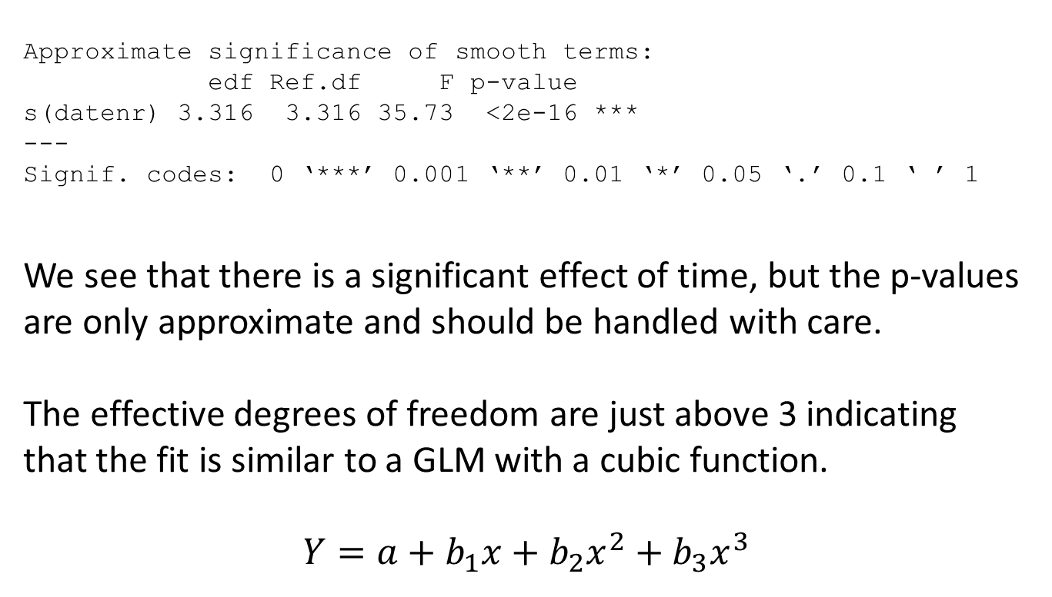
Output and interpretation of GAMs:
summary(model1c$gam)
Approximate significance of smooth terms:
edf Ref.df F p-value
s(datenr) 3.316 3.316 35.73 <2e-16 ***
---
Signif. codes: 0 ‘***’ 0.001 ‘**’ 0.01 ‘*’ 0.05 ‘.’ 0.1 ‘ ’ 1
We see that there is a significant effect of time, but the p-values are only approximate and should be handled with care.
The effective degrees of freedom are just above 3 indicating that the fit is similar to a GLM with a cubic function.
$$Y=a+b_{1}x+b_{2}x_{}^{2}+b_{3}x^{3}$$

Slide 23
Output and interpretation of GAMs:
Using the model above we get the green line.
A cubic regression model would give similar results = the red line.
The complexities of the models are similar.

Slide 24
Output and interpretation of GAMs:
summary(model1c$gam)
Approximate significance of smooth terms:
edf Ref.df F p-value
s(datenr) 3.316 3.316 35.73 <2e-16 ***
---
Signif. codes: 0 ‘***’ 0.001 ‘**’ 0.01 ‘*’ 0.05 ‘.’ 0.1 ‘ ’ 1
Unlike ’traditional’ regression we can not interpret any coefficients or express the estimated curve by a formula.
Instead we visualise the fit by plotting.

Slide 25
Output and interpretation of GAMs:
gam.check(model1c$gam)
Residual checking can be done in much the same way as for traditional GLMs.
Basic assumptions:
normality of residuals
equality of variances

Slide 26
Output and interpretation of GAMs:
As usual, p-values and confidence intervals rely on the assumption of independence of observations.
Independence needs to be ensured when collecting data.
Here we have a time series of observations → the observations are certainly not independent from each other.
If data is collected as a time series, in space or by a hierarchical/clustered/nested scheme, dependencies can be estimated within the model. See GAMM tomorrow.

Slide 27
Output and interpretation of GAMs:
For a subset of the dataset (December values) we get the following output:
Family: gaussian
Link function: identity
Formula:
logTot.P ~ s(datenr, bs = "tp")
Parametric coefficients:
Estimate Std. Error t value Pr(>|t|)
(Intercept) 6.4865 0.1361 47.67 <2e-16 ***
---
Signif. codes: 0 ‘***’ 0.001 ‘**’ 0.01 ‘*’ 0.05 ‘.’ 0.1 ‘ ’ 1
Approximate significance of smooth terms:
edf Ref.df F p-value
s(datenr) 1 1 4.285 0.046 *
---
Signif. codes: 0 ‘***’ 0.001 ‘**’ 0.01 ‘*’ 0.05 ‘.’ 0.1 ‘ ’ 1
R-sq.(adj) = 0.0829
Scale est. = 0.64795 n = 36

Slide 28
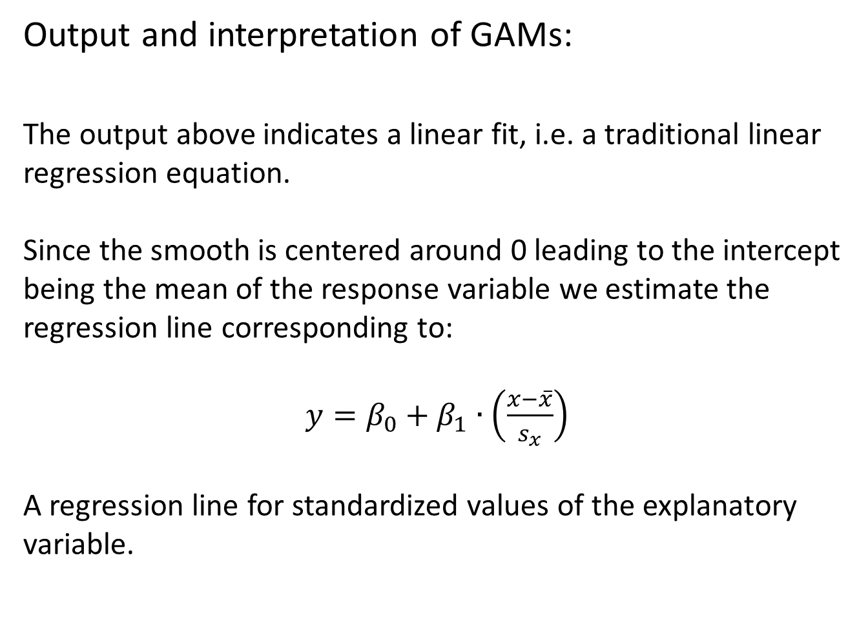
Output and interpretation of GAMs:
The output above indicates a linear fit, i.e. a traditional linear regression equation.
Since the smooth is centered around 0 leading to the intercept being the mean of the response variable we estimate the regression line corresponding to:
$y=β_{0}+β_{1}∙\left(\frac{x−\overline{x}}{s_{x}}\right)$
A regression line for standardized values of the explanatory variable.

Slide 29
Output and interpretation of GAMs:
Create a standardised explanatory variable
river_subset$date_std<-(river_subset$datenr-mean(river_subset$datenr, na.rm=T))/sd(river_subset$datenr)
Fit a linear regression model to the data
model1g<-lm(logTot.P~date_std, data=river_subset)
Coefficients:
Estimate Std. Error t value Pr(>|t|)
(Intercept) 6.4865 0.1380 46.99 <2e-16 ***
date_cent -0.2857 0.1400 -2.04 0.0491 *
---
Signif. codes: 0 ‘***’ 0.001 ‘**’ 0.01 ‘*’ 0.05 ‘.’ 0.1 ‘ ’ 1
Residual standard error: 0.8283 on 34 degrees of freedom
Multiple R-squared: 0.1091, Adjusted R-squared: 0.08288
F-statistic: 4.163 on 1 and 34 DF, p-value: 0.04914

Slide 30
Output and interpretation of GAMs:
From the GAM output:
Parametric coefficients:
Estimate Std. Error t value Pr(>|t|)
(Intercept) 6.4865 0.1361 47.67 <2e-16 ***
---
Signif. codes: 0 ‘***’ 0.001 ‘**’ 0.01 ‘*’ 0.05 ‘.’ 0.1 ‘ ’ 1
Approximate significance of smooth terms:
edf Ref.df F p-value
s(datenr) 1 1 4.285 0.046 *
---
Signif. codes: 0 ‘***’ 0.001 ‘**’ 0.01 ‘*’ 0.05 ‘.’ 0.1 ‘ ’ 1
R-sq.(adj) = 0.0829
Scale est. = 0.64795 n = 36
Residual variance is not exactly the same: 0.8283²=0.686

Slide 31
Output and interpretation of GAMs:
The slope estimate can be found in the lme-output of the GAM fit:
summary(model1f$lme)
Random effects:
Formula: ~Xr - 1 | g
Structure: pdIdnot
Xr1 Xr2 Xr3 Xr4 Xr5
StdDev: 3.795559e-05 3.795559e-05 3.795559e-05 3.795559e-05 3.795559e-05
Xr6 Xr7 Xr8 Residual
StdDev: 3.795559e-05 3.795559e-05 3.795559e-05 0.8049558
Fixed effects: y ~ X - 1
Value Std.Error DF t-value p-value
X(Intercept) 6.486455 0.1380488 34 46.98668 0.0000
Xs(datenr)Fx1 -0.281668 0.1380488 34 -2.04035 0.0491
The regression coefficient is slightly different since variance estimates are different = standardization results are not exactly the same. This only works for tp splines.

Slide 32
Output and interpretation of GAMs:
The Xs(datenr)Fx1 coefficient is connected to the light blue basis function.

Slide 33
Specifying GAM models:
As with traditional GLM models we could be interested in specifying models with
- several explanatory variables, categorical or continuous
- interactions between explanatory variables
We could also be interested to let some of the explanatory variables have a parametric form (e.g. linear), whereas others are smooth.

Slide 34
Modelling in GAM: several explanatory variables
Several numerical or categorical explanatory variables can be included in a GAM.
Usually an additive structure is used, but interactions can be specified.
model2 <-gamm(logTot.P~s(datenr)+s(logRunoff), data=river)
Parametric coefficients:
Estimate Std. Error t value Pr(>|t|)
(Intercept) 5.78712 0.02192 264 <2e-16 ***
---
Signif. codes: 0 ‘***’ 0.001 ‘**’ 0.01 ‘*’ 0.05 ‘.’ 0.1 ‘ ’ 1
Approximate significance of smooth terms:
edf Ref.df F p-value
s(datenr) 7.27 7.27 87.39 <2e-16 ***
s(logRunoff) 2.40 2.40 585.13 <2e-16 ***

Slide 35
Modelling in GAM: several explanatory variables

Slide 36
Modelling in GAM: parametric terms
Not all terms in the model need to be estimated with splines. parametric estimates can be made as well.
river$Month1<-as.factor(river$Month)
model3 <- gamm(logTot.P~s(datenr)+s(logRunoff)+Month1, data=river)
Month1 is a categorical/factor variable indicating months 1-12.
Using the formula above monthly means are estimated in the model.

Slide 37
Modelling in GAM: parametric terms
Parametric coefficients:
Estimate Std. Error t value Pr(>|t|)
(Intercept) 5.54591 0.07325 75.710 < 2e-16 ***
Month12 0.02043 0.09440 0.216 0.828781
Month13 -0.04433 0.09421 -0.471 0.638197
Month14 -0.27011 0.09628 -2.806 0.005265 **
Month15 0.01639 0.10410 0.157 0.875007
Month16 0.40016 0.10867 3.682 0.000263 ***
Month17 0.53832 0.10882 4.947 1.11e-06 ***
Month18 0.56200 0.10918 5.148 4.13e-07 ***
Month19 0.60374 0.10798 5.591 4.16e-08 ***
Month110 0.57104 0.10366 5.509 6.45e-08 ***
Month111 0.39237 0.09754 4.022 6.87e-05 ***
Month112 0.07596 0.09370 0.811 0.418035
---
Approximate significance of smooth terms:
edf Ref.df F p-value
s(datenr) 7.994 7.994 110.9 <2e-16 ***
s(logRunoff) 1.000 1.000 1126.3 <2e-16 ***
---

Slide 38
Modelling in GAM: cyclic terms
An alternative is to estimate a annual cycle to describe the seasonal variation. For this we can use a cyclic cubic regression spline.
model4 <- gamm(logTot.P~s(datenr)+s(logRunoff)+
s(Month, bs='cc'), data=river)
Month is a numerical variable with values 1-12. The choice bs=’cc’ forces the spline to connect the estimate at 12 with the estimate at 1.

Slide 39
Modelling in GAM: cyclic terms
The cyclical spline for seasonal variation. The line connects at 12 and 1.

Slide 40
Modelling in GAM: interactions
If interactions between two variables are expected they can be included in model using a two-dimensional spline.
model5 <- gamm(logTot.P ~ s(datenr, Month) + s(logRunoff), data=river)
Results are difficult to see: highest values in autumn in the 1970s
In the 2000 generally lower values, but still higher in autumn.

Slide 41
Modelling in GAM: interactions
Nicer plots can be obtained by vis.gam()
vis.gam(model5$gam,view=c("datenr","Month"), theta=50)
Perspective plot Contour plot: plot.type=’contour’

Slide 42
Modelling in GAM: interactions
Using the usual s() function for the smooth for interactions uses thin plate splines.
In this option isotropy is assumed, i.e. the same amount of smoothing is used in both directions (time and month).
This could be reasonable for spatial fitting, or for interactions where both variables are in the same unit, but not in our case.
For interactions between variables that should not be smoothed with the same amount, we can use tensor products (te)

Slide 43
Modelling in GAM: interactions
model6 <- gamm(logTot.P~s(logRunoff)+te(datenr, Month), data=river)
Using tensor product Using thin plate spline

Slide 44
Modelling in GAM: main effects and interactions
model7 <- gamm(logTot.P~s(logRunoff)+ti(datenr)+ti(Month)+ ti(datenr, Month) , data=river)
Parametric coefficients:
Estimate Std. Error t value Pr(>|t|)
(Intercept) 5.78607 0.01733 333.9 <2e-16 ***
---
Signif. codes: 0 ‘***’ 0.001 ‘**’ 0.01 ‘*’ 0.05 ‘.’ 0.1 ‘ ’ 1
Approximate significance of smooth terms:
edf Ref.df F p-value
s(logRunoff) 1.000 1.000 1449.71 <2e-16 ***
ti(datenr) 3.932 3.932 259.71 <2e-16 ***
ti(Month) 3.880 3.880 40.41 <2e-16 ***
ti(datenr,Month) 11.510 11.510 12.16 <2e-16 ***

Slide 45
Modelling in GAM: interactions
- smooth for Runoff
- smooth for the main effect date/time
- smooth for the main effect month
- interaction between date and month,

Slide 46
Modelling in GAM: interaction with factor variables
Instead of only modelling seasonality as change in mean values we could be interested to model seasonal trends, i.e. estimating a trend function for each month.
model8<- gamm(logTot.P ~ Month1 + s(datenr, by= Month1) + s(logRunoff), data=river)
The basis functions for date are multiplied by new coefficients for each month allowing separate trend lines.

Slide 47
Modelling in GAM: interaction with factor variables
Parametric coefficients:
Estimate Std. Error t value Pr(>|t|)
(Intercept) 5.54419 0.06349 87.330 < 2e-16 ***
Month12 0.01643 0.08136 0.202 0.840025
Month13 -0.05111 0.08120 -0.629 0.529471
Month14 -0.27725 0.08306 -3.338 0.000931 ***
Month15 0.02210 0.09024 0.245 0.806673
Month16 0.41154 0.09441 4.359 1.70e-05 ***
Month17 0.55346 0.09458 5.852 1.08e-08 ***
Month18 0.56096 0.09503 5.903 8.11e-09 ***
Month19 0.60296 0.09390 6.421 4.17e-10 ***
…
Approximate significance of smooth terms:
edf Ref.df F p-value
s(datenr):Month11 1.000 1.000 10.99 0.00101 **
s(datenr):Month12 1.000 1.000 23.73 1.62e-06 ***
s(datenr):Month13 1.785 1.785 15.12 8.69e-05 ***
s(datenr):Month14 1.000 1.000 34.19 1.06e-08 ***
s(datenr):Month15 3.867 3.867 24.36 < 2e-16 ***
s(datenr):Month16 4.074 4.074 38.89 < 2e-16 ***
s(datenr):Month17 5.106 5.106 35.63 < 2e-16 ***
s(datenr):Month18 4.546 4.546 41.31 < 2e-16 ***
s(datenr):Month19 4.945 4.945 38.09 < 2e-16 ***
…

Slide 48
Modelling in GAM: interaction with factor variables
Trend lines for
March until June.

Slide 49
Modelling in GAM: variable selection
There are no procedures for automatic variable selection in mgcv::gamm (but there is in the gam package).
Instead there are some specialised basis functions that allow shrinkage: ’ts’ and ’cs’
model9 <- gamm(logTot.P ~ s(datenr, bs='ts') + s(Month, bs='ts') + s(logRunoff, bs=’ts’) + s(Abs._F, bs='ts'), data=river)
If we add a variable that is not improving the model fit the smooth is put to a straight line (0 estimated degrees of freedom).

Slide 50
Modelling in GAM: variable selection
with shrinkage
Approximate significance of smooth terms:
edf Ref.df F p-value
s(datenr) 7.816e+00 9 97.10 <2e-16 ***
s(Month) 6.282e+00 9 14.27 <2e-16 ***
s(logRunoff) 2.390e+00 9 128.32 <2e-16 ***
s(Abs._F) 2.727e-07 9 0.00 0.931
without shrinkage:
Approximate significance of smooth terms:
edf Ref.df F p-value
s(datenr) 7.953 7.953 109.068 <2e-16 ***
s(Month) 6.482 6.482 19.042 <2e-16 ***
s(logRunoff) 1.000 1.000 305.858 <2e-16 ***
s(Abs._F) 1.000 1.000 0.183 0.669

Slide 51
Modelling in GAM: variable selection
with shrinkage without shrinkage

Slide 52
Modelling in GAM: inference and uncertainty
For all models the smoothing paramters are determined by optimising the ability to predict new data.
For the function
gam usually generalised cross validation (GCV) is used,
gamm (restricted) maximum likelihood estimation for the smoothing parameter is used.
Unless specifically stated a smoothness selection is therefore conducted in the model.

Slide 53
Modelling in GAM: inference and uncertainty
p-values and confidence intervals do not take inte account the uncertainty from the smoothing parameter estimate.
They are therefore only approximate for smooth terms and are often underestimated.
Use p-values and intervals with care.

Slide 54
Tomorrow: generalized and mixed models
The GAM models can also be used for other distributions than normal, e.g. Poisson for count data or Binomial for 0/1 data.
Correlation between residuals can be estimated in the models to account for temporal or spatial autocorrelations.
Data collected in hierarchical sampling designs can be analyzed with GAMM as well by including random factors that describe the sampling design.

