Slide 1
Using GAMs in Wildlife management

Slide 2
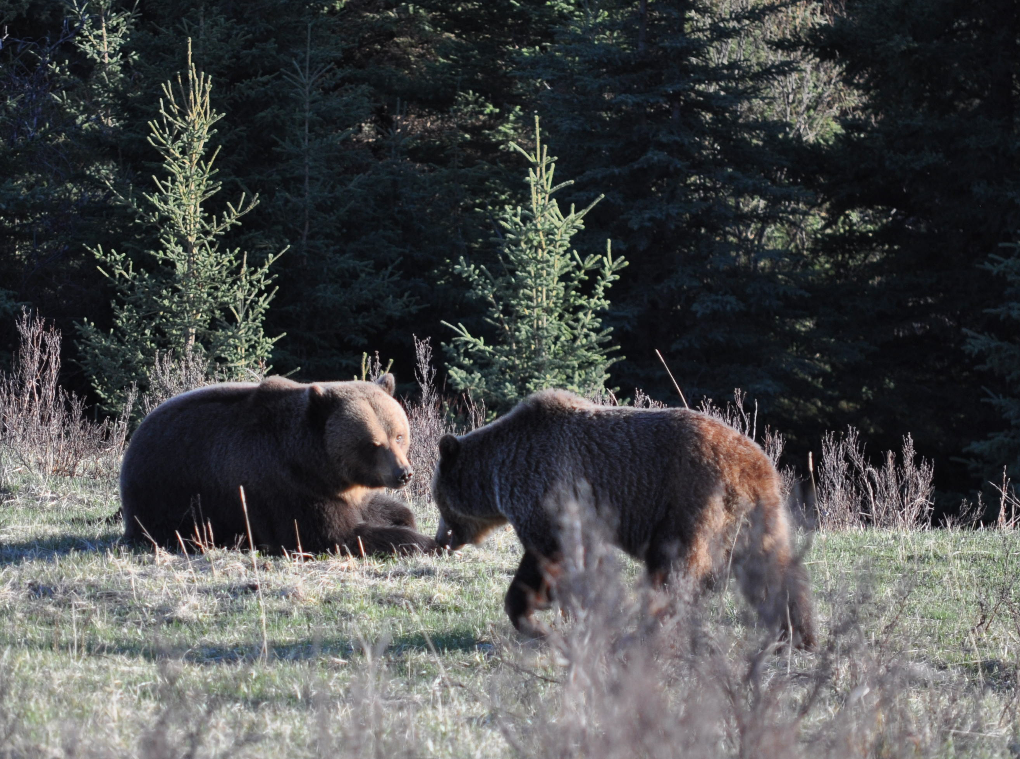
Count the bears

Slide 3
Adult brownbear in Dalarna

Slide 4
Brownbear in Dalarna

Slide 5
Juvenile brownbear in Dalarna

Slide 6
The next step
We know how many bears there were 2001 (286)

Slide 7
The next step
We know how many were shot each year (x, y, z etc)

Slide 8
The next step
We can estimate each years population (P) with P2002=P2001*1.09-(x,y,z etc)

Slide 9
The next step
Using this approach we made a growth model that we fitted to the GAM as best we could, resulting in 450 bears (with huge margins of error) in 2012

Slide 10
The next step
The bear scat survey in 2012 estimated the population at 415 bears….

Slide 11
The next step
We know how many bears there were 2001 (286)
We know how many were shot each year (x, y, z etc)
We can estimate each years population (P) with P2002=P2001*1.09-(x,y,z etc)
Using this approach we made a growth model that we fitted to the GAM as best we could, resulting in 450 bears (with huge margins of error) in 2012
The bear scat survey in 2012 estimated the population at 415 bears….

Slide 12
Analysing animal movement behaviour

Slide 13
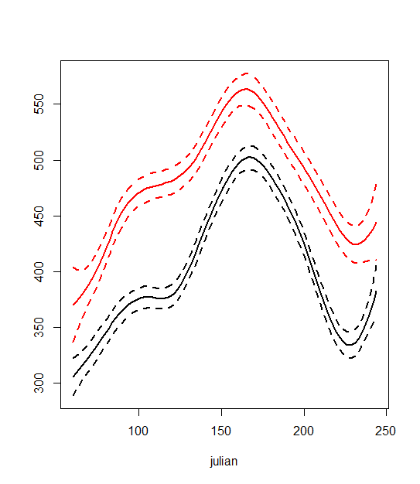
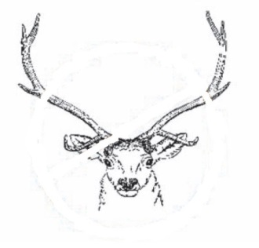
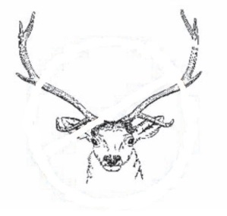
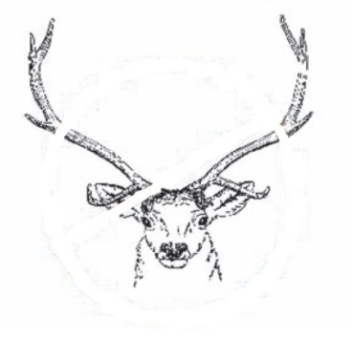
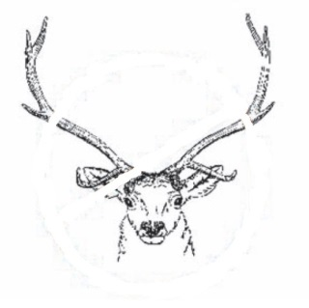
Human selection of elk behavioural traits
n = 16
Step length*
(meters)
harvested
2 y.o.
n = 31
survived
March April May June July August
Hunting season
*Smoothed predicted values (95% Cis)
Julian date (days)
Ciuti et al. 2012 Proc R Soc B

Slide 14
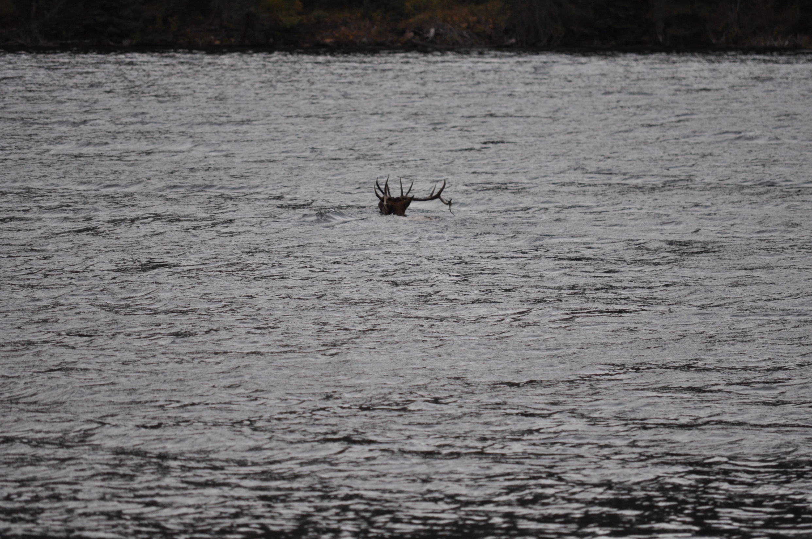
Behaviour~Environmental factors+Human activity*Age
1|Individual
1|Individual
Age|Individual
Behavioural trait
Best model by ∆AIC 1861.9
Notes:
Model structure

Slide 15
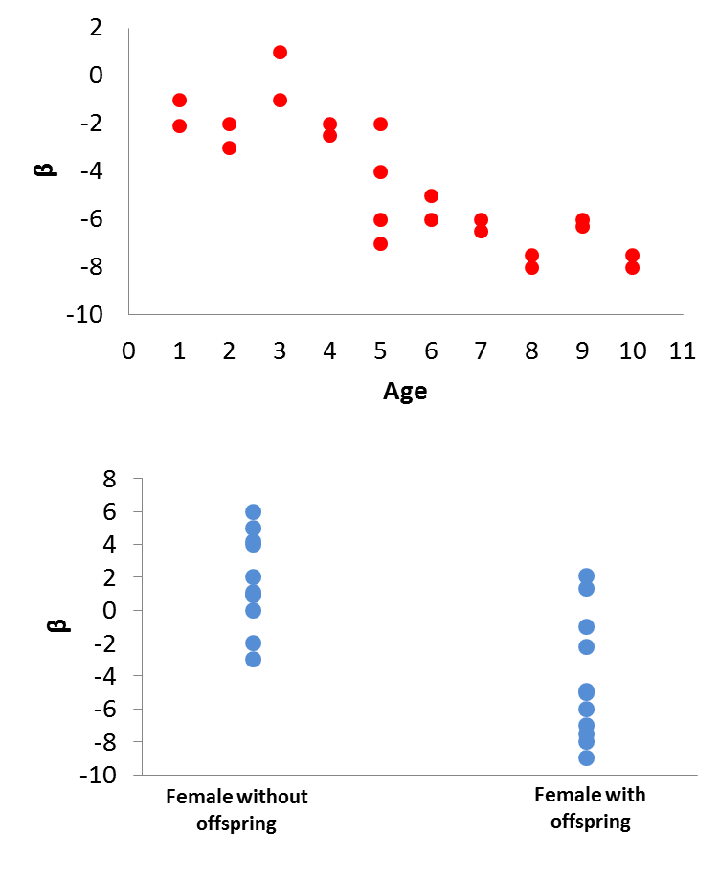
Analyses
Conditional logistic regression, random effects and the two-step method

