Slide 1

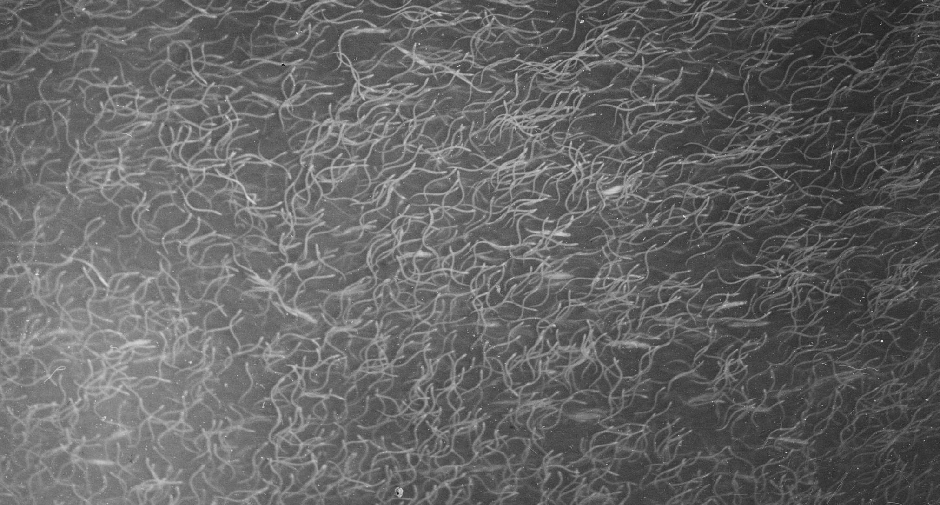


GAM models of eel recruits: few data, many zeroes, many questions
Onsdag 2016-03-16 - Tisdagskaffeseminarium
Sveriges lantbruksuniversitet
Swedish University of Agricultural Sciences
Department of Aquatic Resources
Institute for Freshwater Research
Drottningholm
Wednesday 2016-08-24 – GAM course, Statistics@SLU, Ultuna
Willem . Dekker @ SLU . SE

Slide 2
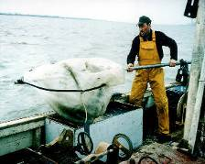


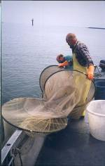







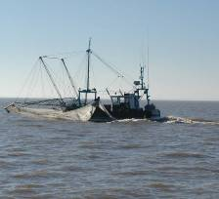




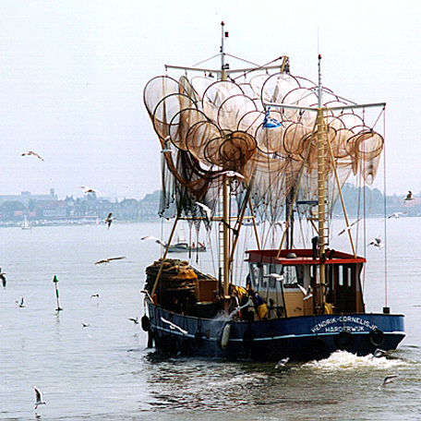
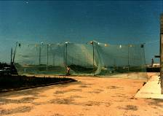


Slide 3
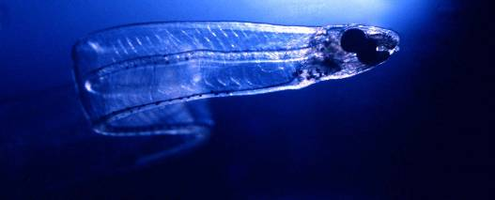
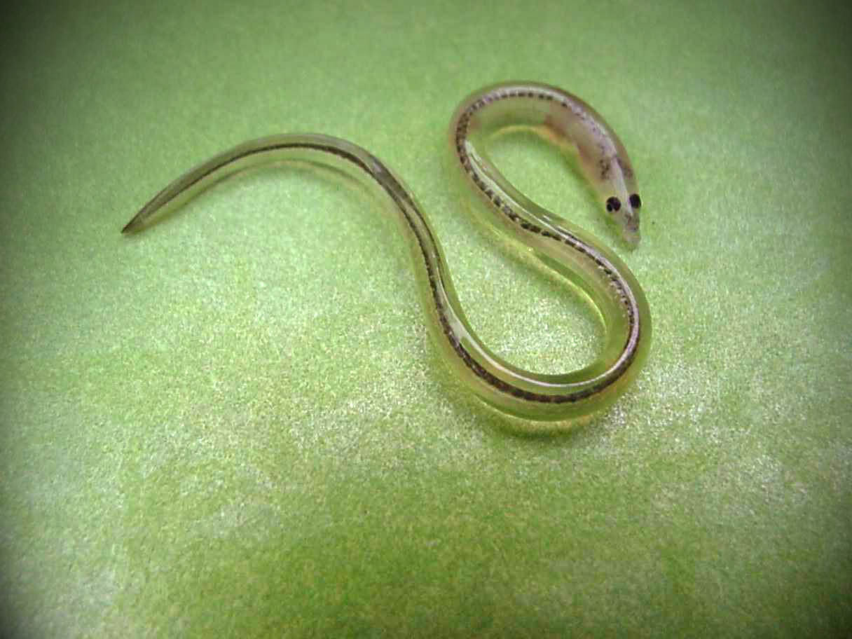
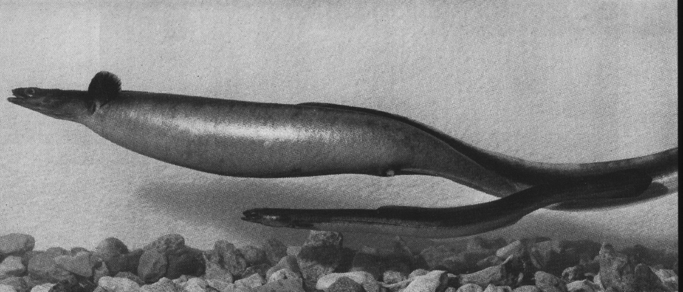
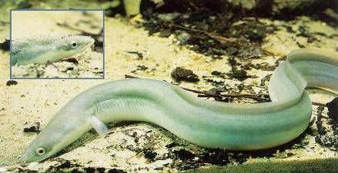
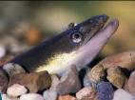
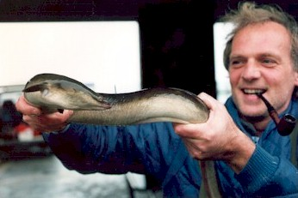
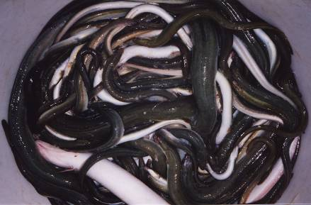
Leptocephalus
Glass eel
Silver eel
Yellow eel

Slide 4
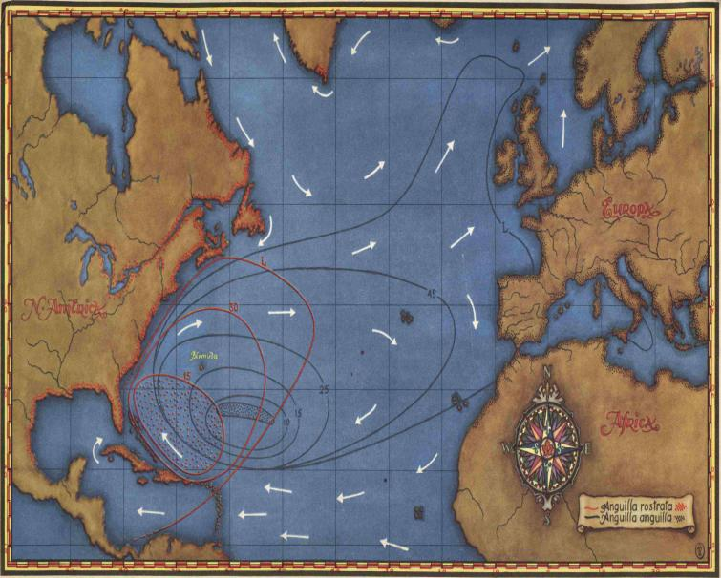

Sargasso

Slide 5



Slide 6
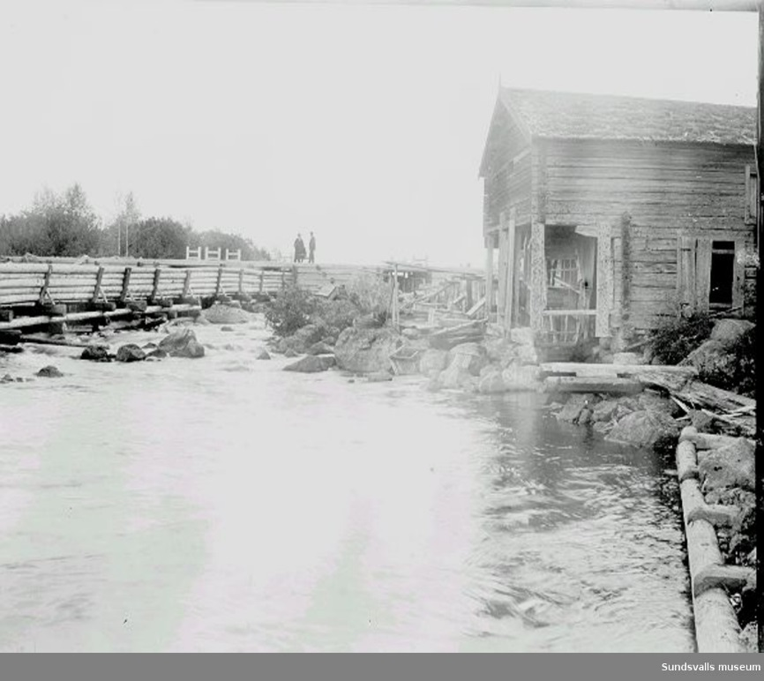
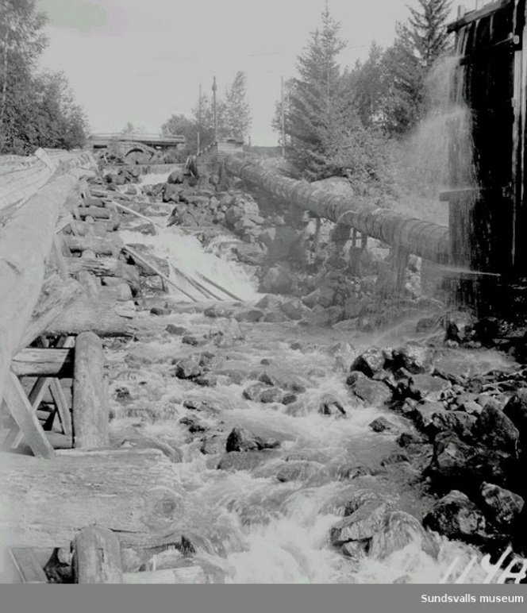
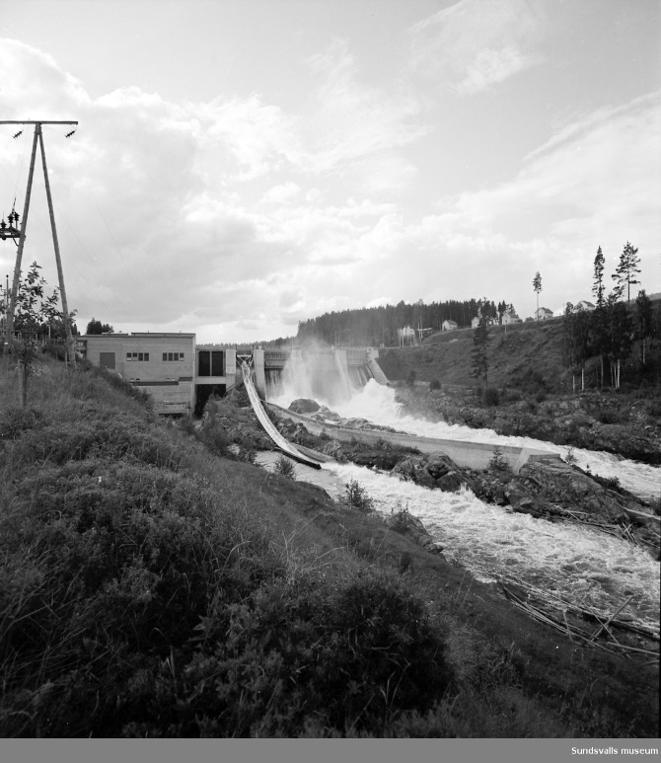
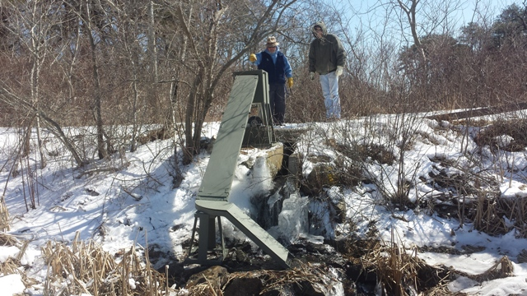
C. Puke, Svensk Fiskeri Tidskrift 1955 – Uppsamling och transport av ålyngel i nedre Norrland

Slide 7
1976
Two hypotheses:
Svärdson 1976 - shrinking distribution Oslo
Dekker 2004 - older eels declined first Age
Test two alternatives, uses a lot of df’s
Need to minimize on df-usage, parsimony!
Now: not yet comparing hypotheses; to be continued!

Slide 8
Selecting an appropriate model
Data:
1 observation per year per site, if available.
Numbers or total weight (and number/kg) – all converted to numbers, now.
#years = 75 time trend
#sites = 24 local conditions and peculiarities
#obs = 994 (75*24 = 1800, nearly half is missing)
Y = year + site assumes equal trends
Y = year + site + year*site repeats the data
Y = year + site + β_{site}*continuous(year) different patterns, but linear patterns
Y = year + site + β_{year}*continuous(site) different trends over time, linear in site
Y = year + site + β_{site} *Mandel(year)
Y = year + site + β_{year}*Mandel(site)
Y = spline(year, site)
reduction of 6% on df= 6 for Age
reduction of 20% on df=21 for Oslo
✗
✗
✗
✗
✗
✗
✓
Mandel J. 1959 The analysis of Latin squares with a certain type of row-column interaction. Technometrics 1, 379-387.

Slide 9
GAM results

Slide 10
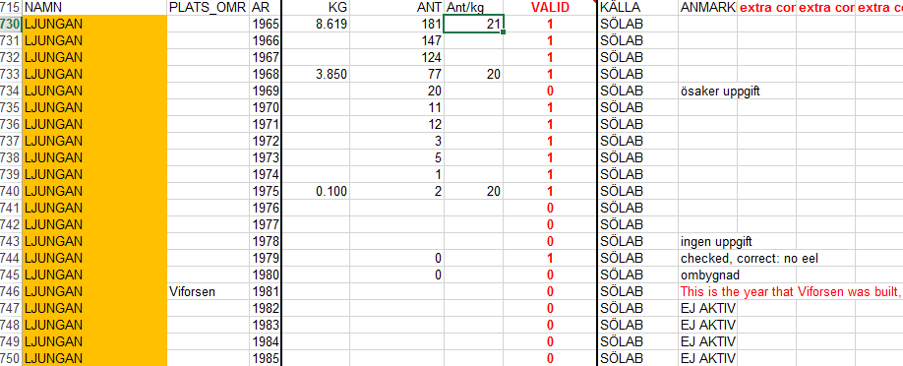
Giving up too soon?

Slide 11
Near zero is uncertain
Gamma
Poisson
Normal
Normal σ² ≈ const
Poisson σ² ≈ μ
Gamma σ² ≈ μ²
Log-normal, log(y+1), μ >1: ≈Gamma, μ<1: ≈Normal. Choose “1” well!
or Negative Binomial, but automatic fit often foolish.

Slide 12

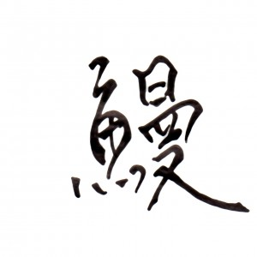
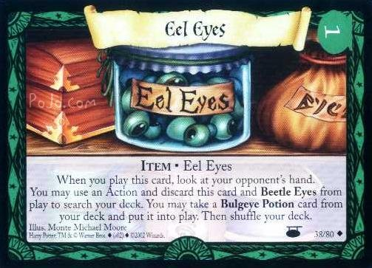
Conclusions
GAM is a flexible technique for fitting complex relations
Parsimony of resulting models is a pro
Lack of analytical interpretation is a con, GAM is a descriptive technique
Know your data!
Know your (statistical) assumptions, and their effects. Check!
Do not rely on default settings – they might not apply for you. Check!

Slide 13
A. Paul Weber 1974: Tote Fische - denn sie wissen nicht, was sie tun!

