Slide 1
Geographically weighted regression model – identifying spatially differentiated relationships and trends
Claudia von Brömssen, Dept of energy and technology, SLU

Slide 2
Geographically varying relationships
Modelling of relationships, not levels. No time component.
Spatial models often assume that the relationship between a response and an explanatory variable is contant over space.
For Swedish data, with a clear gradient in space, such an assumption can be problematic and should be verified.
Notes:
Study several sites simultaneously
Easy to include information on where the trends happen.

Slide 3
Geographically varying relationships
Example dataset:
Response: anion neutralizing capacity (ANC)
Explanatory variables:
sulfate (SO₄)
buffering capacity (BC)
chloride (Cl)
Data is modelled by MAGIC-model.
Notes:
Study several sites simultaneously
Easy to include information on where the trends happen.

Slide 4
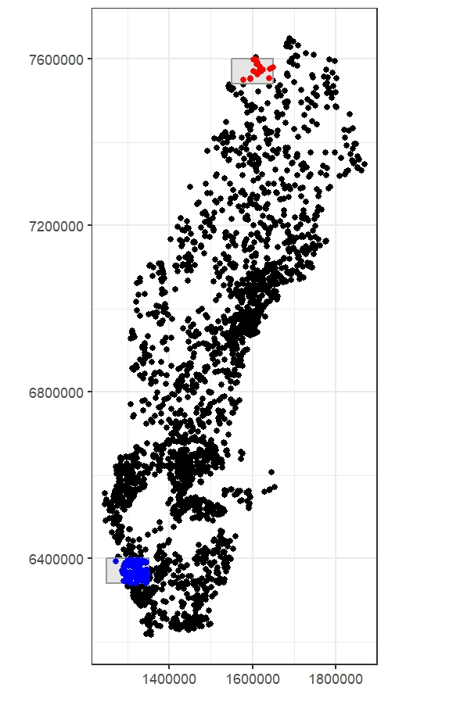
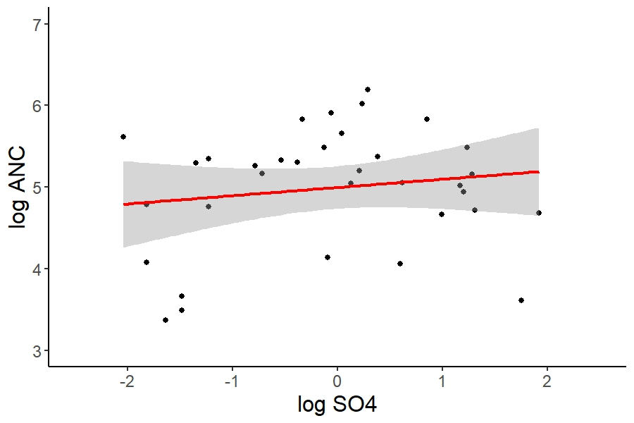
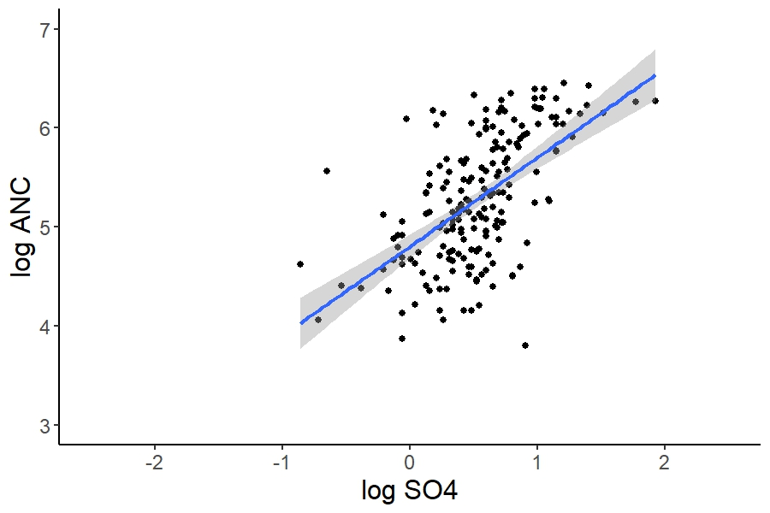
ANC_{log}= 5 + 0.1 SO4_{log} p-value: 0.39 R²=0
ANC_{log}= 4.8 + 0.9 SO4_{log} p-value: <0.001 R²=34%
Notes:
Study several sites simultaneously
Easy to include information on where the trends happen.

Slide 5
Estimating coefficients varying in space:
  Regional analysis: working with subsets
  Spatial moving window approach – geographically weighted regression models
  Varying coefficient model, fitted e.g. with a general additive model
Notes:
Study several sites simultaneously
Easy to include information on where the trends happen.

Slide 6
Geographically weighted regression models
Used to determine relationships between a response and one or several explanatory variables if
  the relationships are expected to change (slowly) over space
  the relationship between variables within a geographical window can be assumed to be linear
Notes:
Study several sites simultaneously
Easy to include information on where the trends happen.

Slide 7
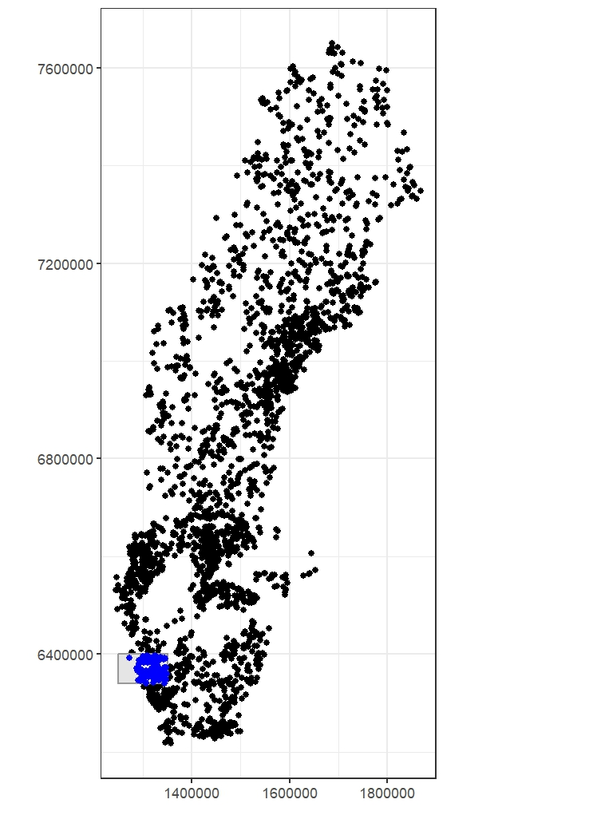
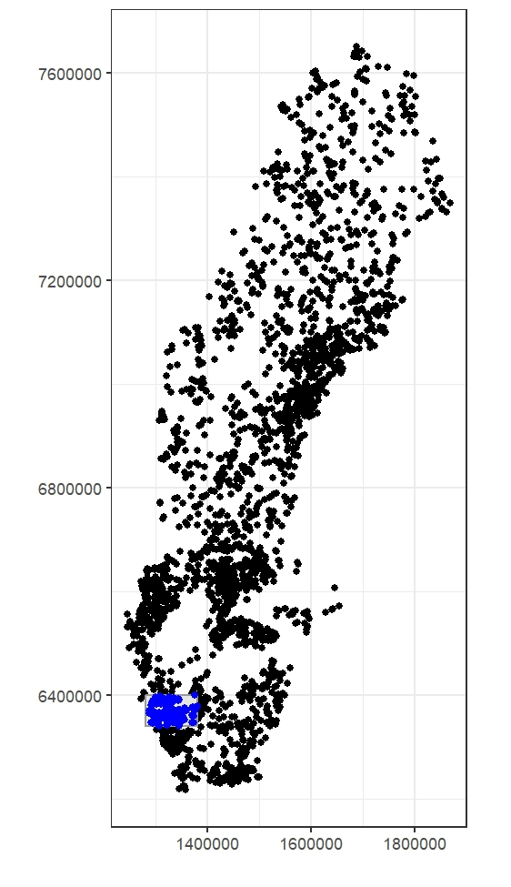
ANC_{log}=4.8 + 0.9 SO4_{log} p-val: <0.001 R²=34%
Notes:
Study several sites simultaneously
Easy to include information on where the trends happen.

Slide 8
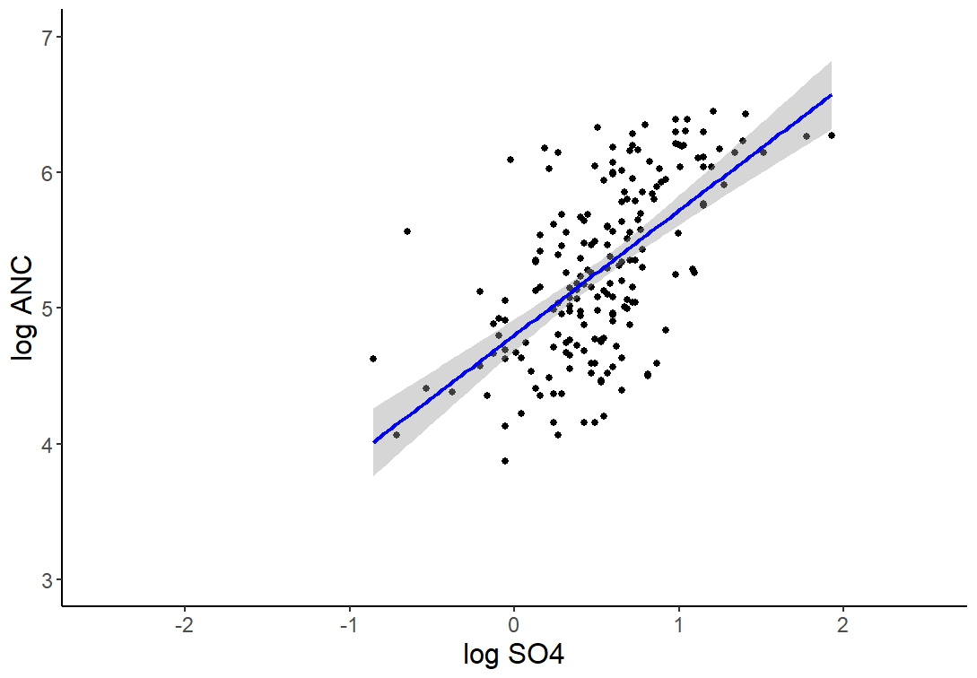
ANC_{log}=4.8 + 0.9 SO4_{log} p-val: <0.001 R²=34%
ANC_{log}=4.8 + 0.92 SO4_{log} p-val: <0.001 R²=36%
Notes:
Study several sites simultaneously
Easy to include information on where the trends happen.

Slide 9
Geographically weighted regression models
How is the geographical window defined?
Notes:
Study several sites simultaneously
Easy to include information on where the trends happen.

Slide 10
Geographically weighted regression models
What to decide:
  Structure of the window
    dependent on geographical distances or
    dependent on the number of neighbouring observations
  Size of the window (in distance or number of observations)
Notes:
Study several sites simultaneously
Easy to include information on where the trends happen.

Slide 11
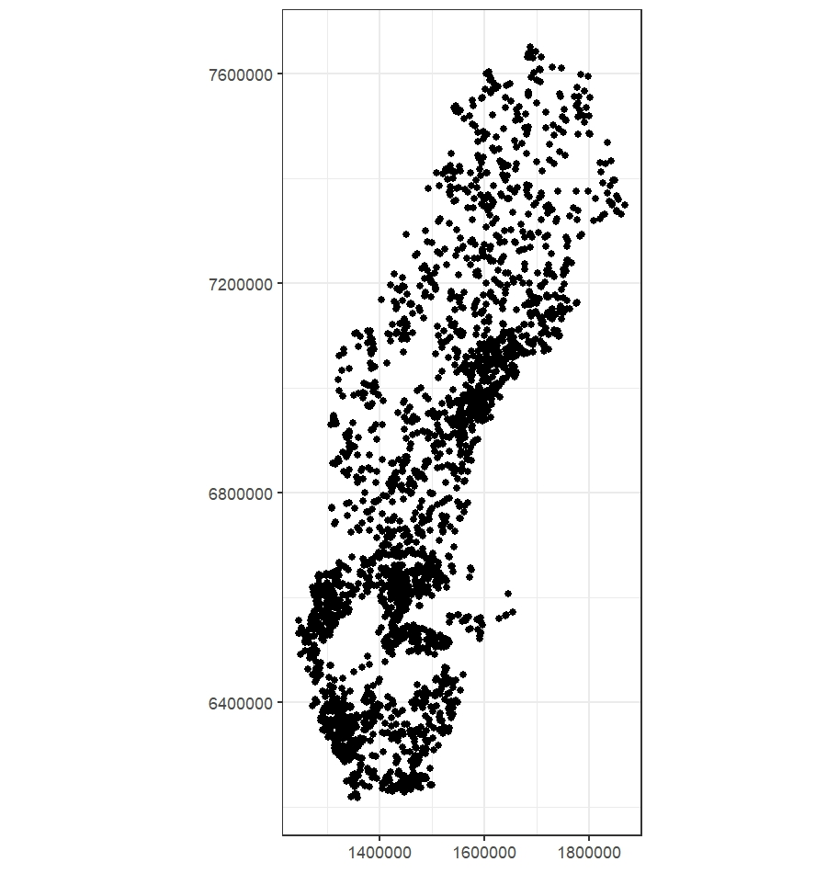
Geographically weighted regression models
Bandwidth describes the size of the window
Adaptive bandwidth:
a window consisting of the n nearest neighbours
equally many observations in each window
Non-adaptive bandwidth:
fixed size determined by distance
equal size of the geographical area
Notes:
Study several sites simultaneously
Easy to include information on where the trends happen.

Slide 12
Weighted regression models
Weighted regression means that different observations get different weights, e.g. due to
- uncertainties associated varies with observation
- importance of observation varies
Here, weights are determined by the distance of an observation to the target observation (= the midpoint of the geographical window). The closer the more weight in the model fit.
Notes:
Study several sites simultaneously
Easy to include information on where the trends happen.

Slide 13
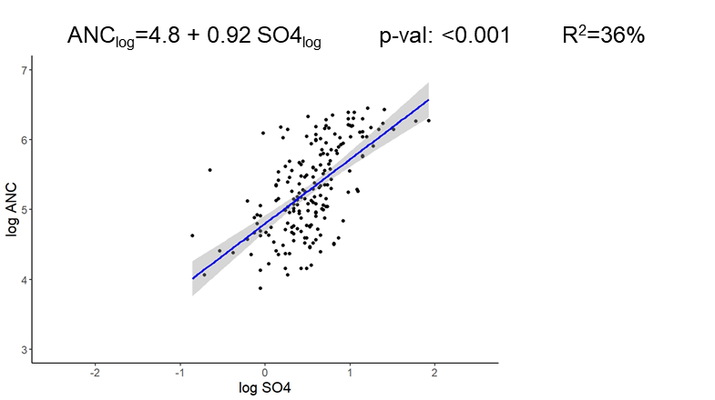
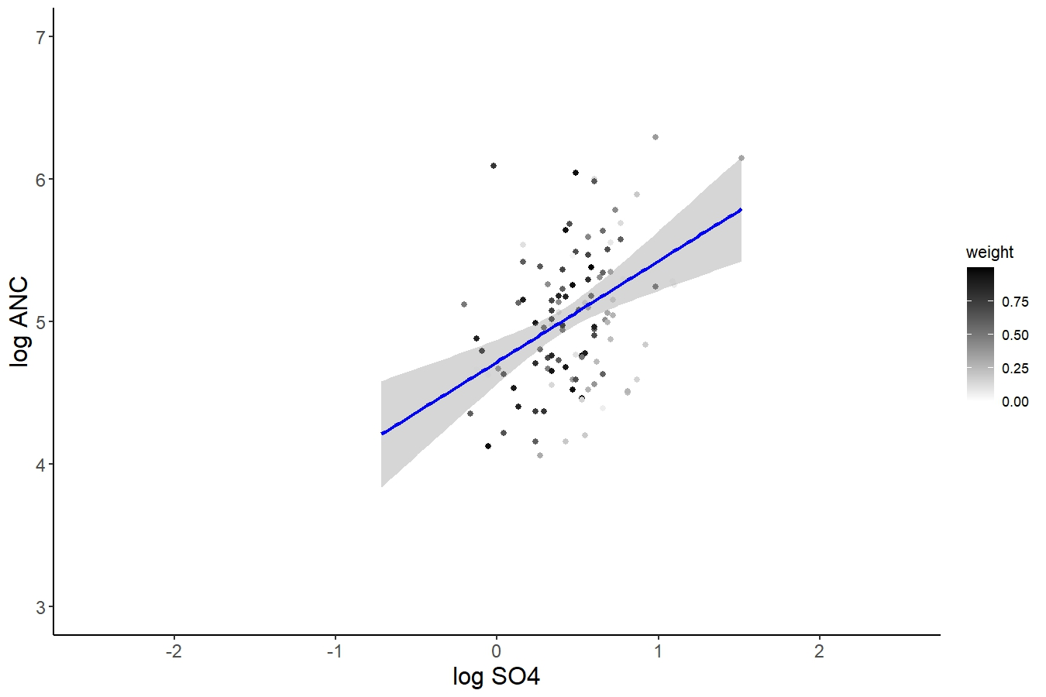
Weighted regression models
ANC_{log}=4.72+0.71 SO4_{log} p-val:<0.001 R²=14%
Notes:
Study several sites simultaneously
Easy to include information on where the trends happen.

Slide 14
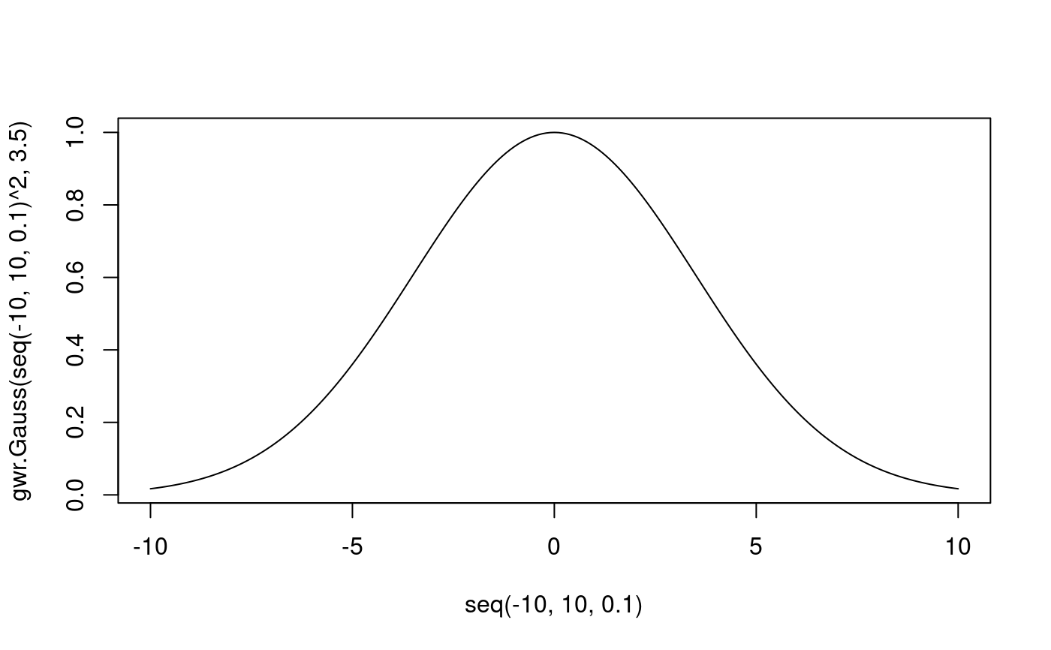
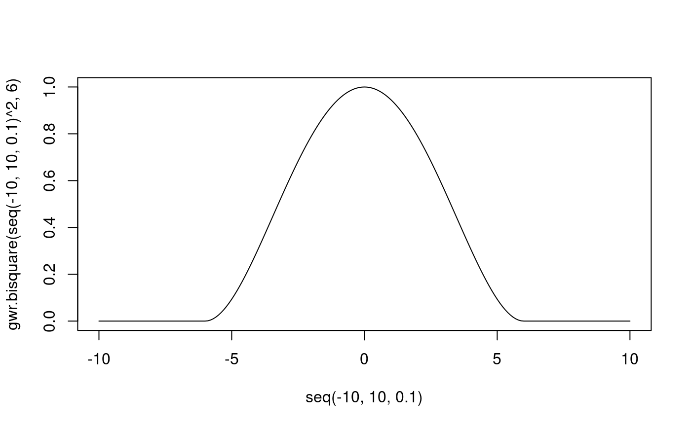
Geographically weighted regression models
Weights are computed from a weighting functions, e.g.
Gaussian
Bisquare
Notes:
Study several sites simultaneously
Easy to include information on where the trends happen.

Slide 15
Output of geographically weighted regression models
  Estimated coefficients change smoothly over space – observations removed from a window have already low weights.
  No assumption on spatial patterns are needed.
  Spatially varying coefficients can be visualised and interpreted.
Notes:
Study several sites simultaneously
Easy to include information on where the trends happen.

Slide 16
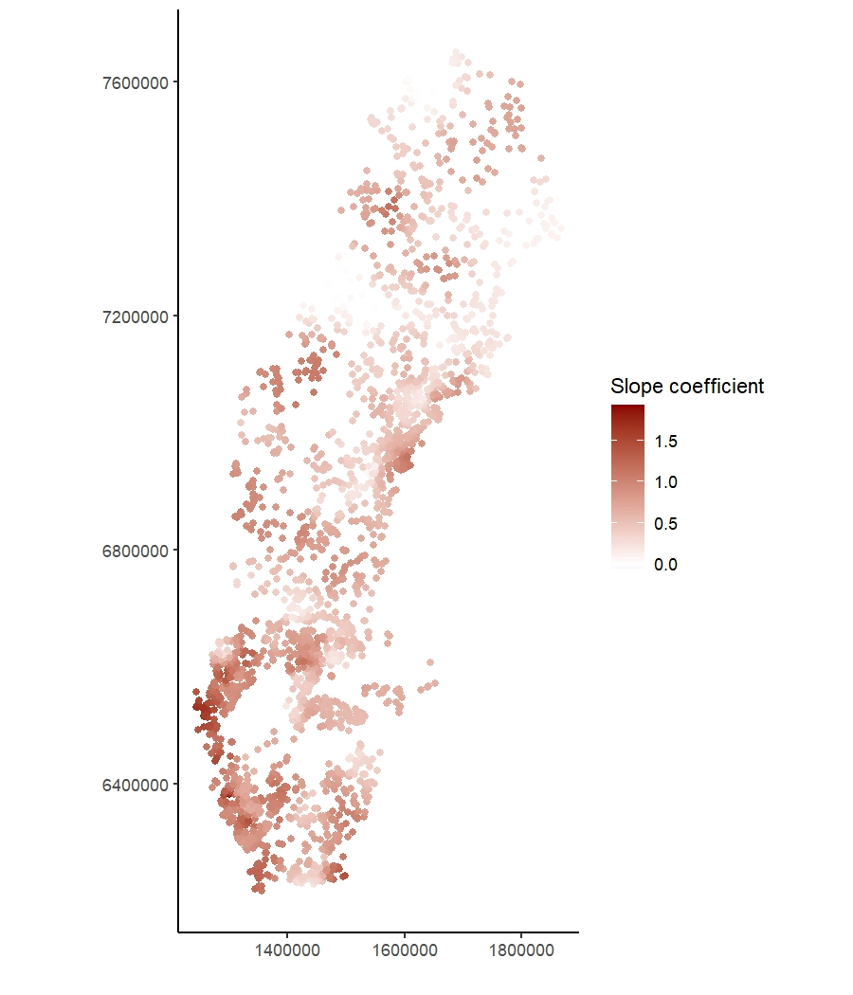
Lower or no positive slopes
High positive slopes
Notes:
Study several sites simultaneously
Easy to include information on where the trends happen.

Slide 17
Model output – Local R² and significance tests
GWR fit a linear (weighted) regression model in each window, therefore also
  - R² values are available for each window
  - Significant tests of the slope coefficient can be computed for each window
Notes:
Study several sites simultaneously
Easy to include information on where the trends happen.

Slide 18
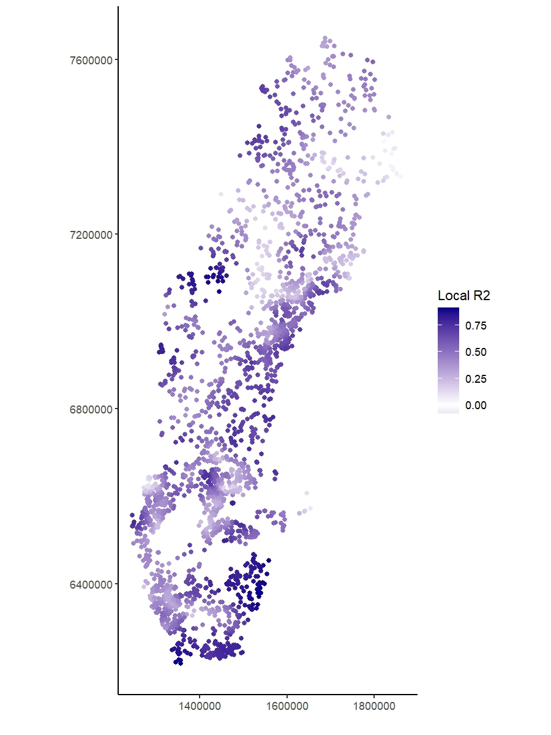
Low R² values
High R² values
Notes:
Study several sites simultaneously
Easy to include information on where the trends happen.

Slide 19
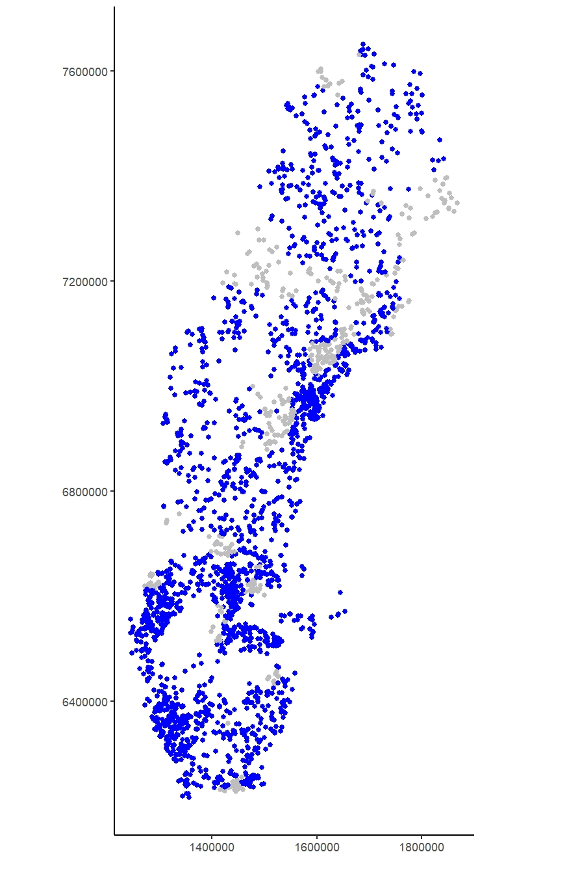
Significant slope coefficient in blue. Non-significant in gray.
BUT:
Problem with multiple testing
Tests are not independent
Notes:
Study several sites simultaneously
Easy to include information on where the trends happen.

Slide 20
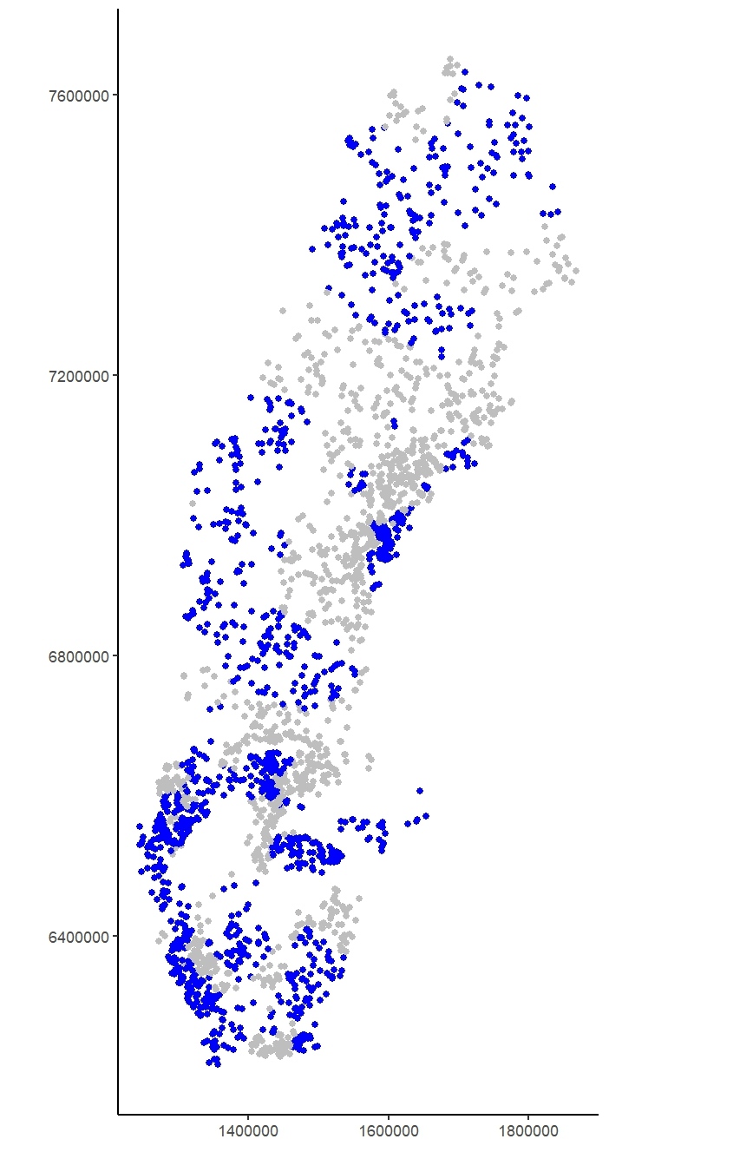
Adustment can be made, e.g by Bonferronis method
Recommendation:
Use geographically weighted regression models as visualisation method rather than hypothesis testing method.
Notes:
Study several sites simultaneously
Easy to include information on where the trends happen.

Slide 21
Geographically weighted regression models
Size of window – bandwith
  can be set by user or
  selected by crossvalidation
Due to the large amount of regression models geographically weighted regression models are often computationally heavy.
User-selected bandwidth increases speed, but might lead to less reliable results.
Notes:
Study several sites simultaneously
Easy to include information on where the trends happen.

Slide 22
Geographically weighted regression models
For single explanatory variables computation time is usually not a problem even if the bandwith is optimized by e.g. cross-validation.
Parallell computation options and scalable versions are available in R.
Notes:
Study several sites simultaneously
Easy to include information on where the trends happen.

Slide 23
GWR model in R (package GWmodel)
Make a spatial data set and compute distances
ANClakes.spdf <- SpatialPointsDataFrame(spatial2[, c("X", "Y")], spatial2)
distances<-gw.dist(coordinates(ANClakes.spdf))
Compute the appropriate bandwidth using cross-validation:
bw<-bw.gwr(log_anc ~ log_so4_cent,adaptive=TRUE, kernel="bisquare", dMat=distances, parallel.method="omp", data=ANClakes.spdf)
Notes:
Study several sites simultaneously
Easy to include information on where the trends happen.

Slide 24
GWR model in R (package GWmodel)
Fit the model
model_anc<-gwr.basic(log_anc ~ log_so4,
adaptive=TRUE,
bw=bw,
dMat=distances,
kernel="bisquare",
parallel.method="omp",
data=ANClakes.spdf)
Notes:
Study several sites simultaneously
Easy to include information on where the trends happen.

Slide 25
GWR model output in R
To large extend a visualisation method.
Model outputs are summarized including:
- The global model
- The geographically weighted model
Notes:
Study several sites simultaneously
Easy to include information on where the trends happen.

Slide 26
Model output – Result of Global regression
Residuals:
Min 1Q Median 3Q Max
-2.47018 -0.29058 0.03148 0.34287 1.49063
Coefficients:
Estimate Std. Error t value Pr(>|t|)
(Intercept) 3.64760 0.04916 74.19 <2e-16 ***
log_so4 0.44316 0.01405 31.53 <2e-16 ***
Residual standard error: 0.499 on 2435 degrees of freedom
Multiple R-squared: 0.2899
Adjusted R-squared: 0.2896
F-statistic: 994.2 on 1 and 2435 DF, p-value: < 2.2e-16
Notes:
Study several sites simultaneously
Easy to include information on where the trends happen.

Slide 27
Model output – Result of GWR
********Model calibration information**************
Kernel function: bisquare
Adaptive bandwidth: 61 (number of nearest neighbours)
Regression points: the same locations as observations are used.
Distance metric: Euclidean distance metric is used.
*******Summary of GWR coefficient estimates:**********
Min. 1st Qu. Median 3rd Qu. Max.
Intercept -2.709958 2.171123 3.099874 3.846460 5.3314
log_so4 -0.058193 0.411564 0.617109 0.856310 1.9212
Notes:
Study several sites simultaneously
Easy to include information on where the trends happen.

Slide 28
Model output – Result of GWR
Notes:
Study several sites simultaneously
Easy to include information on where the trends happen.

Slide 29
GWR with several explanatory variables
Several explanatory variables can be included in the analysis
The bandwith for individual explanatory variables can be
  The same – Basic GWR
  Different – Multiscale GWR
Different bandwidth are used if variables function on different spatial scales. BUT: bandwith selection is very computationally expensive.
Notes:
Study several sites simultaneously
Easy to include information on where the trends happen.

Slide 30
Basic GWR with several explanatory variables
We could include SO4, BC and Cl as explanatory variables
Problem of multicollinearity is present also in GWR.
We expect coefficients for SO4 to change when BC is included, since they describe (to some extend) the same effect.
Notes:
Study several sites simultaneously
Easy to include information on where the trends happen.

Slide 31
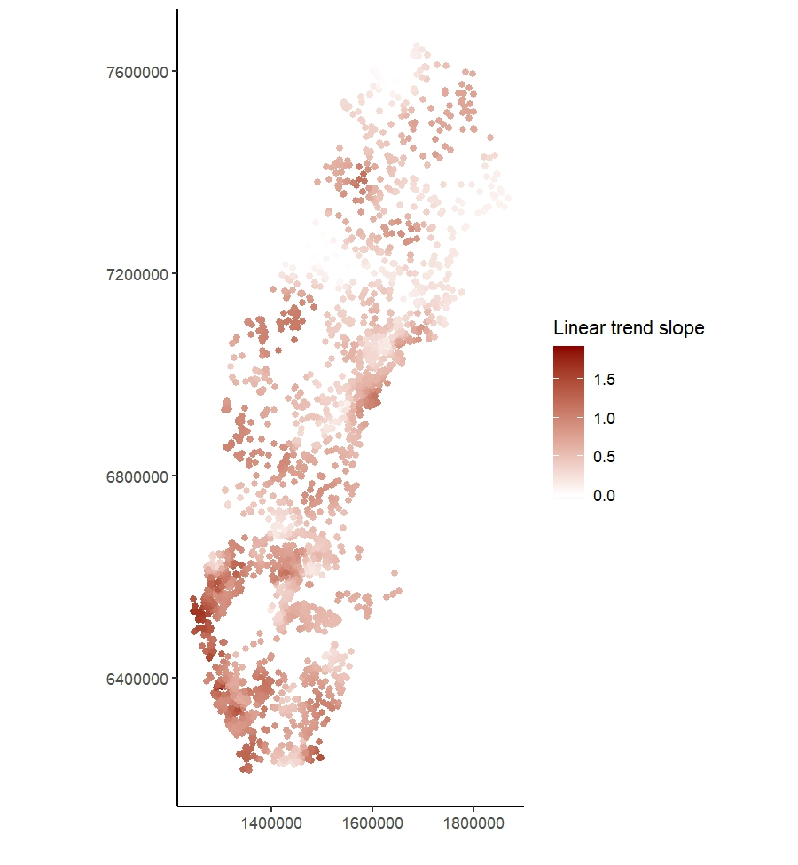
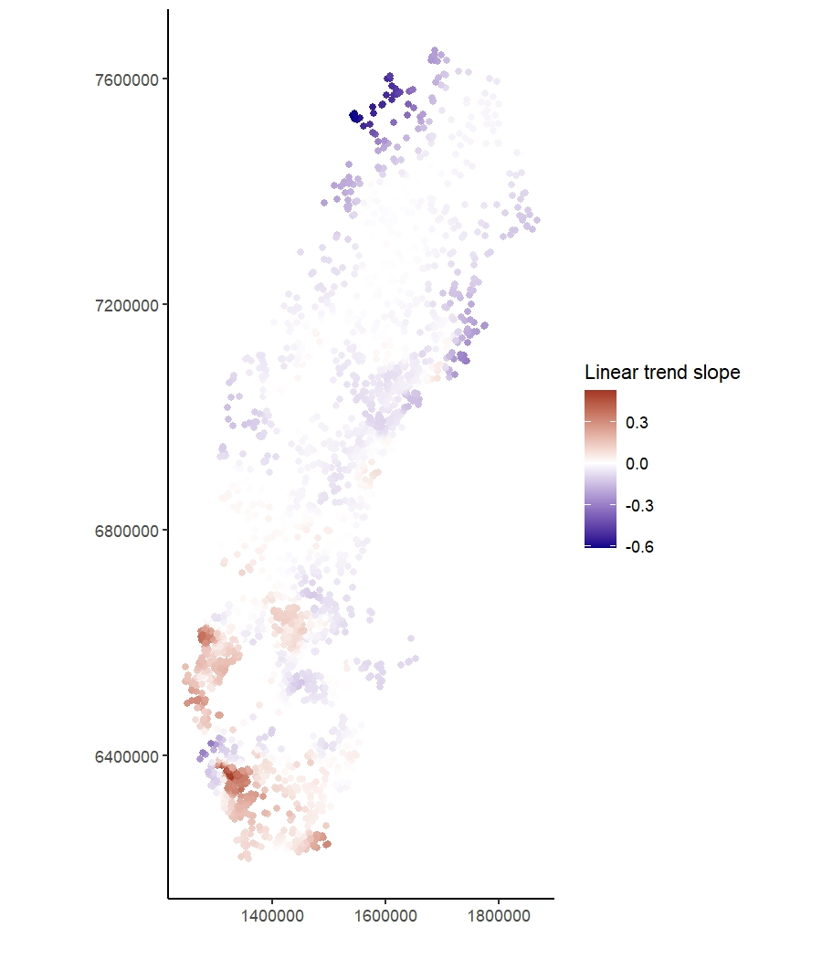
Coefficients for SO4 in the univariate model
Coefficients for SO4 in the multiple model
Notes:
Study several sites simultaneously
Easy to include information on where the trends happen.

Slide 32
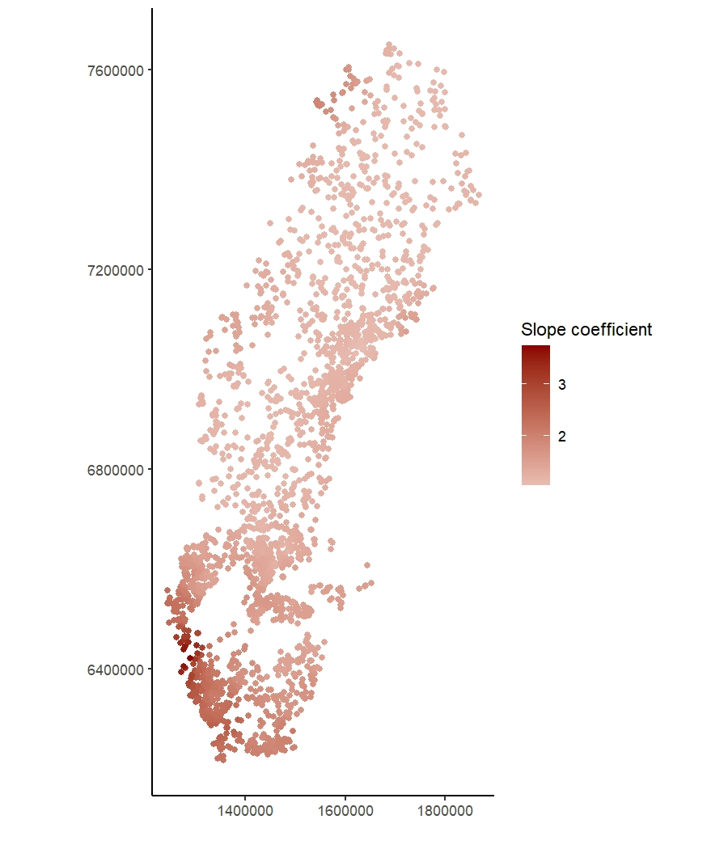
Coefficients for SO4 in the univariate model
Coefficients for BC in the multiple model
Notes:
Study several sites simultaneously
Easy to include information on where the trends happen.

Slide 33
GWR for the
analysis of temporal trends
Notes:
Study several sites simultaneously
Easy to include information on where the trends happen.

Slide 34
GWR for the analysis of temporal trends
Instead of a spatial snapshot we can use time series data at many stations in space.
If we expect that the temporal trend is similar when stations are geographically close we can use geographically weighted regression models for trend analysis.
Notes:
Study several sites simultaneously
Easy to include information on where the trends happen.

Slide 35
GWR for the analysis of temporal trends
Time can be used as an explanatory variable in GWR.
The model needs to be simple and the relation to time/year linear, i.e. it is best fitted for
  shorter time series
  based on annual data, to avoid seasonal variation
Notes:
Study several sites simultaneously
Easy to include information on where the trends happen.

Slide 36
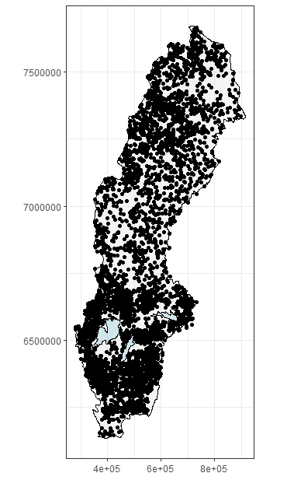
GWR for the analysis of temporal trends
Can be used for sparse data, e.g. if tradtional trend methods do not work
Swedish lake survey (”omdrevssjöar”) revisits approx 5000 lakes once each six years.
Notes:
Study several sites simultaneously
Easy to include information on where the trends happen.

Slide 37
GWR for the analysis of temporal trends
Example of a geographical window: sparse data
Notes:
Study several sites simultaneously
Easy to include information on where the trends happen.

Slide 38
GWR for the analysis of temporal trends
Mean-centering to decrease variation
Notes:
Study several sites simultaneously
Easy to include information on where the trends happen.

Slide 39
GWR for the analysis of temporal trends
Mean-centering to remove station-wise mean levels of the response variable
  - less sensitive to missing and unequally sampled data
  - focus on change rather than level
  - corresponds to including site/station as a (random) factor
Notes:
Study several sites simultaneously
Easy to include information on where the trends happen.

Slide 40
GWR for the analysis of temporal trends
Geographically weighted regression models are fitted as before with time as explanatory variable.
The slope parameter in the regression describes the temporal trend.
It can be relevant to work with temporal windows to allow for ”nonlinearities” in the temporal changes. This would be done in separate analyses for separate time periods.
Notes:
Study several sites simultaneously
Easy to include information on where the trends happen.

Slide 41
GWR for the analysis of temporal trends
Notes:
Study several sites simultaneously
Easy to include information on where the trends happen.

Slide 42
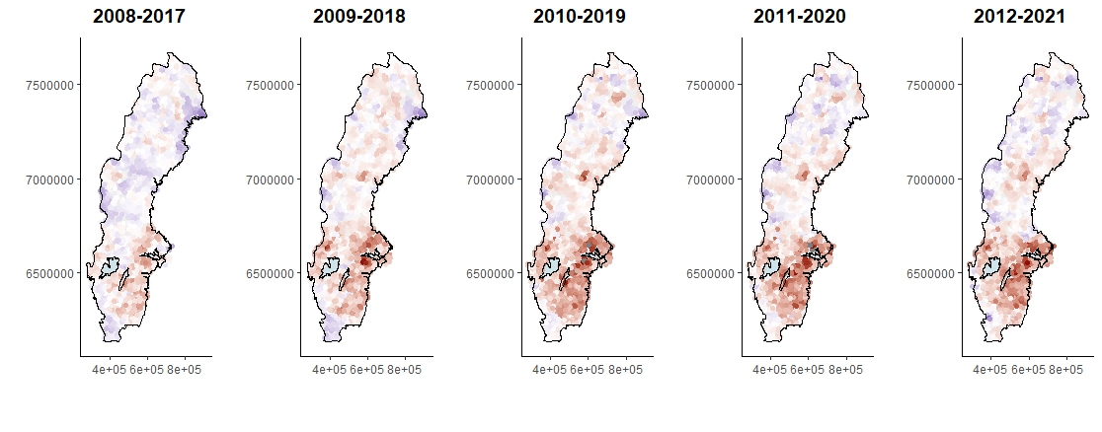
GWR for the analysis of temporal trends: sulfate
Red- positive trend coefficients
Blue – negative trend coefficients
Notes:
Study several sites simultaneously
Easy to include information on where the trends happen.

Slide 43
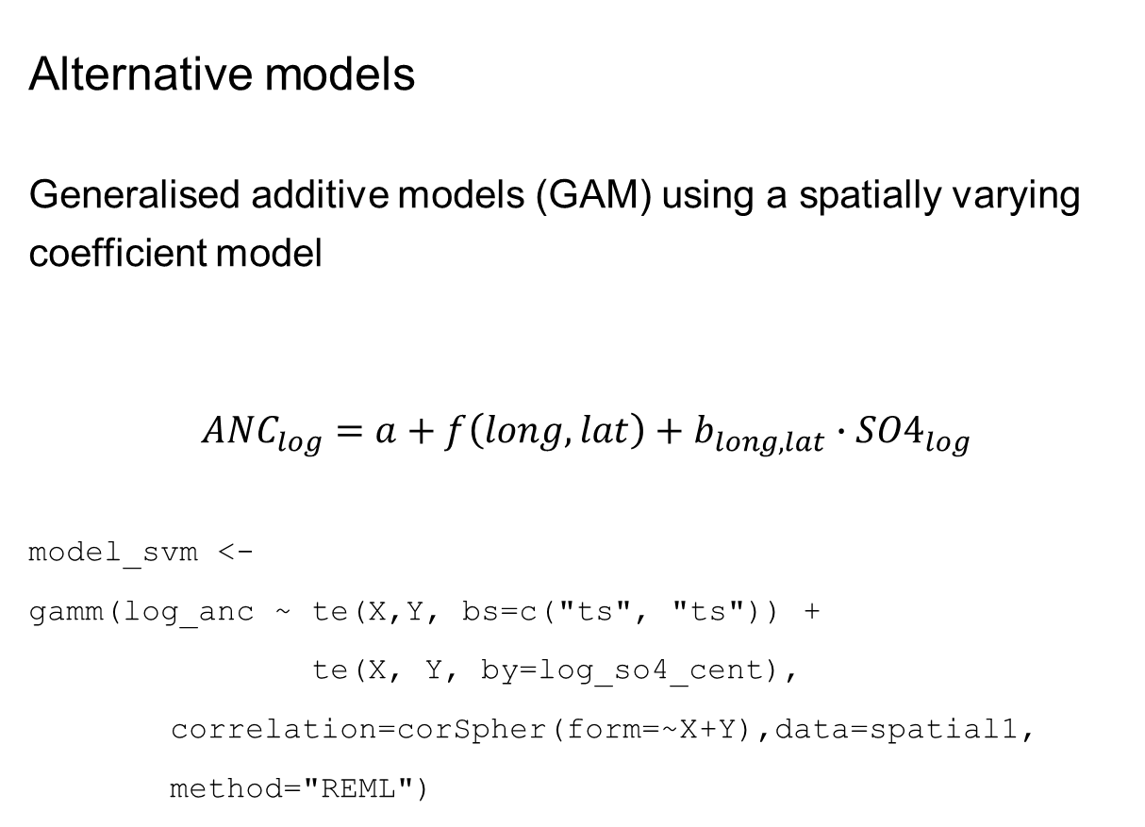
Alternative models
Generalised additive models (GAM) using a spatially varying coefficient model
$${ANC}_{log}=a+f\left(long, lat\right)+b_{long, lat}∙{SO4}_{log}$$
model_svm <-
gamm(log_anc ~ te(X,Y, bs=c("ts", "ts")) +
te(X, Y, by=log_so4_cent),
correlation=corSpher(form=~X+Y),data=spatial1, method="REML")
Notes:
Study several sites simultaneously
Easy to include information on where the trends happen.

Slide 44
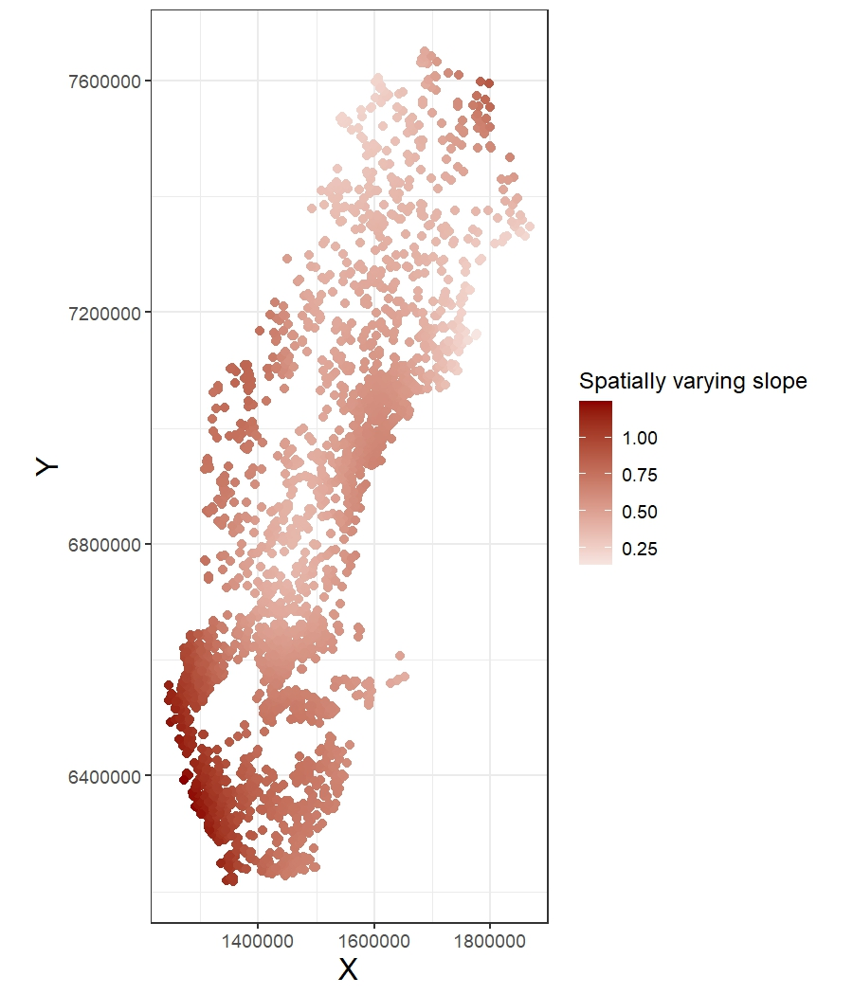
GAM
vs GWR
Notes:
Study several sites simultaneously
Easy to include information on where the trends happen.

Slide 45
GWR in R - GWmodel
GWR – basic model, continuous response
GGWR: generalised GWR – allows for Poisson and Binomial distributions
GTWR: geographically and temporally weighted regression
Mixed GWR: some variables have global relationships while others have local
Multiscale GWR: different relationships need different amount of smoothing/different size of geographical windows
Notes:
Study several sites simultaneously
Easy to include information on where the trends happen.

Slide 46
GWR in R
PCA, Discriminant analysis, ridge regression, robust regression … are also available.
Isabella Gollini, Binbin Lu, Martin Charlton, Christopher Brunsdon, Paul
Harris (2015). GWmodel: An R Package for Exploring Spatial Heterogeneity
Using Geographically Weighted Models. Journal of Statistical Software,
63(17), 1-50. https://doi.org/10.18637/jss.v063.i17
Binbin Lu, Paul Harris, Martin Charlton, Christopher Brunsdon (2014). The
GWmodel R package: further topics for exploring spatial heterogeneity
using geographically weighted models. Geo-spatial Information Science,
17(2), 85-101. https://doi.org/10.1080/10095020.2014.917453
Notes:
Study several sites simultaneously
Easy to include information on where the trends happen.

Slide 47
General references to GWR
Brunsdon, C., Fotheringham, S., & Charlton, M. (1998a). Geographically weighted regression. Journal of the Royal Statistical Society, 47, 431–443. https://doi.org/10.1111/14679884.00145
Comber, A., Brunsdon, C., Charlton, M., Dong, G., Harris, R., Lu, B., Lü, Y., Murakami, D., Nakaya, T., Wang, Y., & Harris, P. (2023). A route map for successful applications of geographically weighted regression. Geographical Analysis, 55, 155–178. https://doi.org/10.1111/gean.12316
For trend analysis:
von Brömssen, C., Fölster, J., Eklöf, K., 2023. Temporal trend evaluation in monitoring programs with high spatial resolution and low temporal resolution using geographically weighted regression models. Environ. Monit. Assess. 195, 547. https://doi.org/10.1007/s10661-023-11172-2
Notes:
Study several sites simultaneously
Easy to include information on where the trends happen.

Slide 48
Statistics@SLU
The Center of Statistics offers statistical advice and support to all employees at SLU free of charge (limit of 20 hours per client and year).
Find a list with SLU statistics consultants at https://www.slu.se/en/centreforstatistics/
Contact: statistics@slu.se
Notes:
Study several sites simultaneously
Easy to include information on where the trends happen.

