Slide 1
POSHMyCo
POTENTIAL OF SELECTIVE HARVEST BASED ON MYCOTOXINS CONTENT ASSESSMENT IN CEREAL CROPS
WP6— Impact evaluation

Slide 2
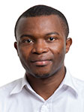
SLU TEAM
Enoch Owusu Sekyere
Carl Johan Lagerkvist
Assem Abu Hatab

Slide 3
AIM
The overall aim of WP6 is to assess the socioeconomic and environmental impacts of the proposed technologies, as well as their adoption potential.
Task 6.1
SOCIOECONOMIC IMPACT
Task 6.2.
ENVIRONMENTAL IMPACT
Task 6.3.
ADOPTION POTENTIAL

Slide 4
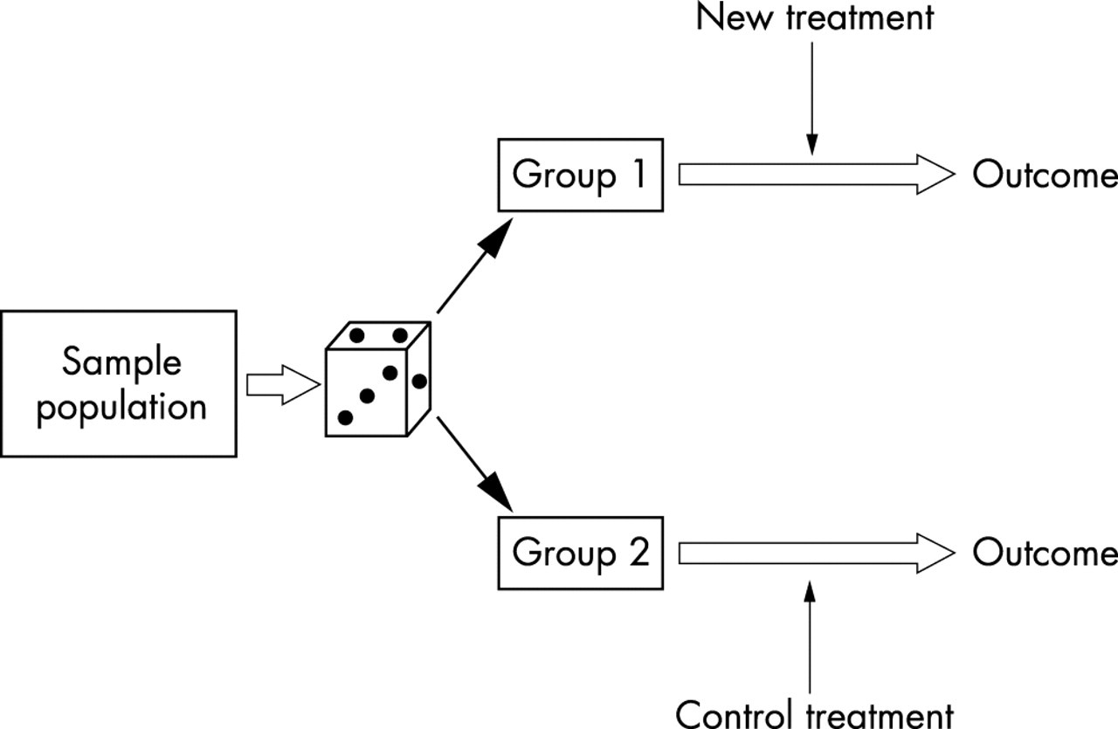
TASK 6.1: ASSESSING THE SOCIOECONOMIC IMPACTS
Randomized control trials (RCT) will be used to assess the impacts of SH and PSSS by collecting baseline and follow-up randomized data in 2021 and 2022 from treated farms as control groups.
A difference-in-difference technique will be used to evaluate the economic impact of the technology on yield, mycotoxin content, market and sales and farm gross margin.

Slide 5
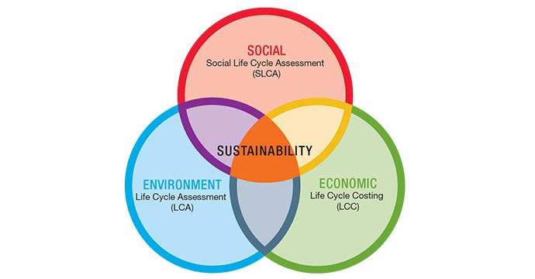
TASK 6.2: EVALUATING THE ENVIRONMENTAL IMPACTS
This task will assess the extent to which the proposed technology is resource saving and environmentally friendly and examine its environmental cost and benefits based on environmental and social life cycle analysis (LCA).
Integrated life cycle approach

Slide 6
TASK 6.3: EXAMINING THE DETERMINANTS OF FARMERS' ADOPTION
A series of individual in-depth interviews and focus group discussions will be carried out with farmers and other key stakeholders to understand factors influencing their adoption of the technology such as liquidity constraints, awareness and accessibility.
A choice experimental approach will be used to assess the potential trade-offs in relation to farmers’ adoption of the technology.

Slide 7
LIST OF WP6 DELIVERABLES

Slide 8
CONTACT
Assem Abu Hatab
Department of Economics
Swedish University of Agricultural Sciences Box 7013, 750 07 UPPSALA, Sweden Phone: +46 (0)18-67 15 67,
Mobile: +46 (0)72-849 98 28 assem.abouhatab@slu.se

