Slide 1
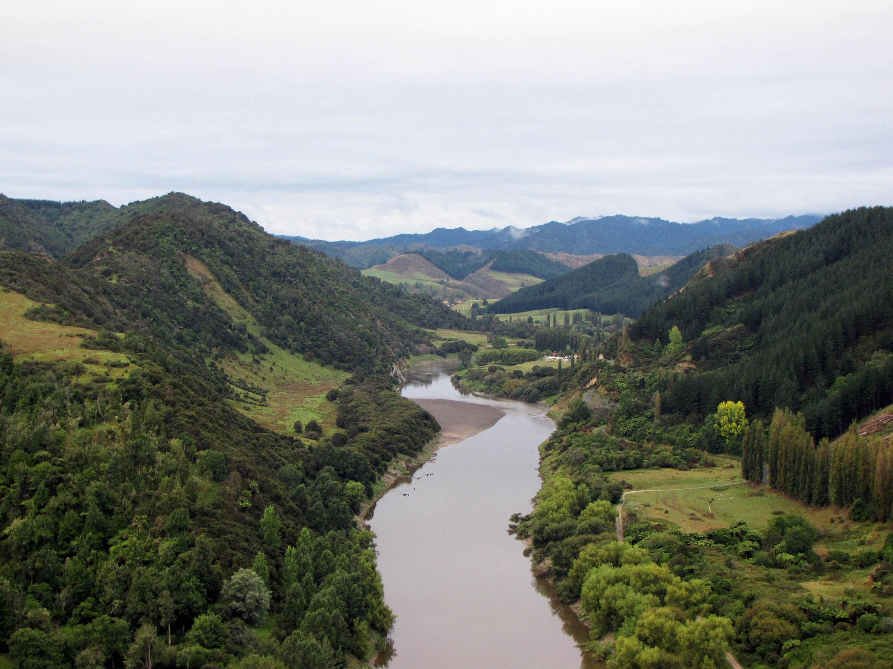
Interdisciplinary seminar
Representing Nature in Law, Policy & Practice
Erica von Essen, PhD
Wouter Blankestijn, MSc Anna Martin, MSc
Swedish University of Agricultural Sciences
10-04-2019

Slide 2
Speakers
Pella Thiel - Ecologist, Naturens Rättigheter Sverige, Lodyn, End Ecocide, UN Harmony with Nature
Jan Darpö - Professor in Environmental Law, Uppsala University
Yaffa Epstein - Researcher in Environmental Law, Uppsala University
Maria Forsberg - Senior Lecturer in Environmental Law, Uppsala University
Carina Green - Researcher in Anthropology at CBM & Uppsala University
Erica von Essen - Researcher in Environmental Communication, SLU

Slide 3
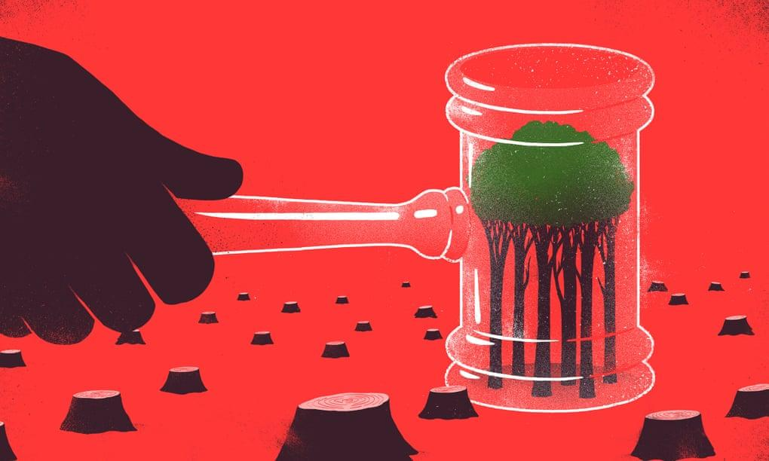
Rights of Nature
Stone 1972: Should trees have standing? Globally growing movement for sustainability: cases and organisations (Paradigm changing) tool for improving human-nature relations and sustainability (Thiel & Hallgren 2018)
“Appropriate behaviour is best communicated through law’’
(Brian Eno in Client Earth, p. xv)
Source: Sebastien Thibault, The Guardian.

Slide 4
From voiceless nature to enfranchised legal entities?
Notes:
As EC students we wondered...this movement seems to offer possibilities to make it very clear by law who can speak nature. Law however does not implement itself, citizen participation is important for implementation → voices that speak on behalf of the environment
Going from a voiceless actor without political or legal agency to a legitimate structure of representation to speak on behalf of non-human nature in an environmental democracy and in legal settings (sorry for forgetting the wolf..). Possibly in a more transparent way than when ENGOs do it perhaps, as set out in the Aarhus convention perhaps?
Now that natural entities gain legal rights, their voices are formally considered and needs to be formally represented by human actors. However on which basis does this happen, how is the process of representing nature facilitated, on which grounds? Natural entities are not the only ‘voiceless’ actor recognised by law, think of disabled persons, corporations, however how is nature claimed to be listened to?
Because a law does not implement itself, citizen participation is important for implementation → voices that speak on behalf of the environment

Slide 5
Representing nature
Based on criteria such as legitimacy, accountability, authorization (Pitkin 1967), presence
Critique on anthropocentric view of representation:
Which criteria are fit then? Communication with nature as feedback (Dryzek 1990), internalization of interests (Goodin 1996), moral norms and deliberation (Eckersley 1999, von Essen & Allen 2016), epistemic claims (O’Neill 2006)
Representation seen as: relational (Saward 2006/2009, Tanasescu 2016) and a social practice (Boström & Uggla 2016)

Slide 6
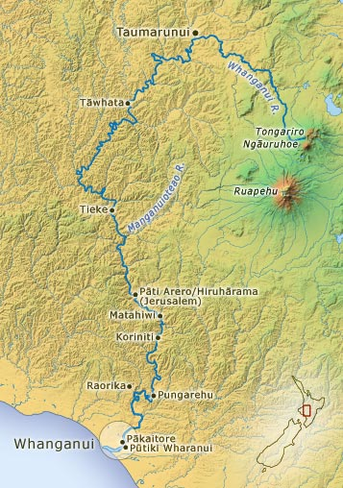
Whanganui — a river with rights
Granted status of legal person in 2017
Appointed human faces of the river as representatives
‘’Ko au te awa, ko te awa ko au - I am the river, the river is me’’
Flexibility of legal personhood
Loophole in current western legal system to have representation based on local and cosmological relations, solve struggles over land ownership
Source: Te Ara

Slide 7
Arising considerations:
Implications beyond the legal context and implementation — deliberative/environmental democracy & ethical and social shifts
Legal expansion to non-human actors — can we speak of legitimate political agency?
Rights of Nature as ‘naturalizing rights’ and reproducing the colonial order (Rawson & Mansfield, 2018) vs finding a pragmatic loophole interweaving different knowledge systems (Salmond 2014), legitimising local ecocultural relations?
What is the added value of Right of Nature compared to other protective measures and environmental legal frameworks to speak on behalf of nonhuman others (e.g. Aarhus Convention)?

Slide 8
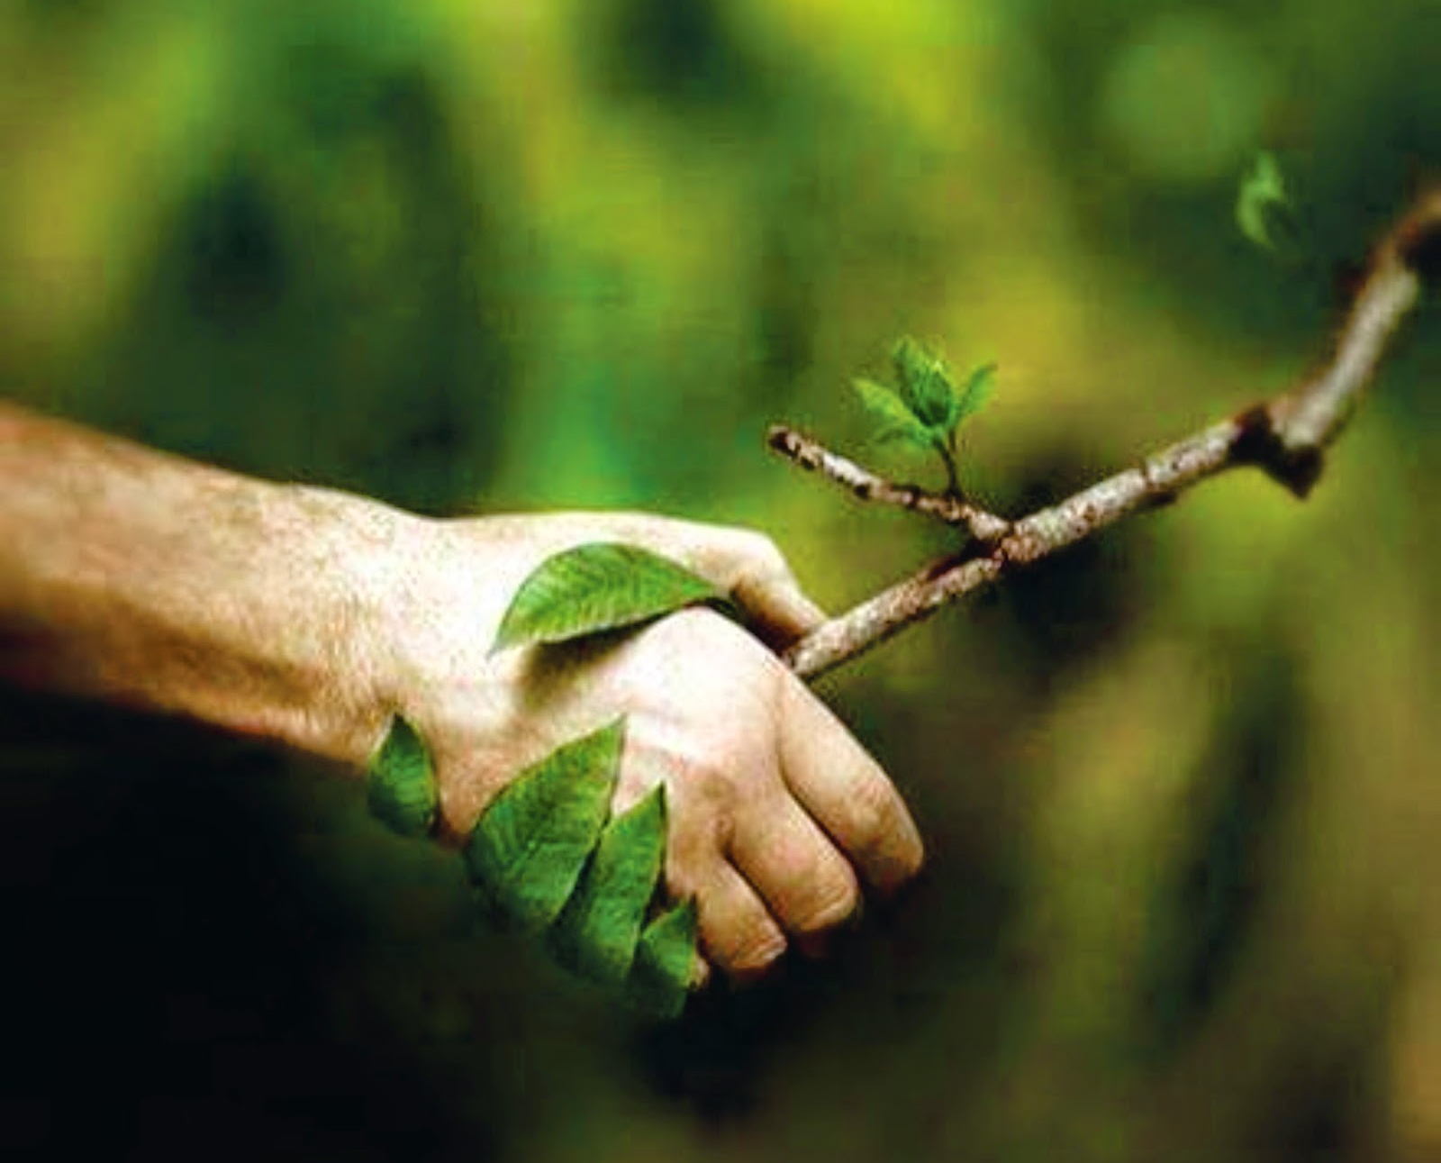
Agenda
3 minute pitch
How do you work with Right of Nature/nature representation?
What do you see as the principal challenges or questions to discuss?
Group discussions - 3-4 topics, 25 minutes discussion, arising questions
General discussion
Wrap up
Source: Yuji Miyata

Slide 9
References
Boström, M. & Uggla, Y. (2016). A sociology of environmental representation. Environmental Sociology, vol. 2 (4), pp. 355-364.
Chapron, G., Epstein, Y. & López-Bao, J.V. (xxxx). A rights revolution for nature. Science Vol. 363, Issue 6434, pp. 1392-1393.
Dobson, A. (1996). Representative Democracy and the Environment. In: Lafferty, W.M. & Meadowcroft, J. (Eds.) Democracy and the Environment: Problems and Prospects. Cheltenham: Edward Elgar Publishing.
Dryzek, J.S. (1990). Green reason: Communicative ethics for the biosphere. Environmental Ethics, 12 (3), pp. 195-210.
Goodin. R. E. (1996). Enfranchising the Earth, and its Alternatives. Political Studies, 44, pp. 835-849.
Eckersley, R. (1999). The discourse ethic and the problem of representing nature. Environmental Politics, 8 (2), pp. 24–49.
O’Neill, J. (2006), “Who Speaks for Nature?”. In J. Haila and C. Dyke (eds), How Nature Speaks: The Dynamics of the Human Ecological Condition. Durham NC: Duke University Press, pp. 261–78.
Rawson, A. & Mansfield, B. (2018). Producing juridical knowledge: “Rights of Nature” or the naturalization of rights? Environment and Planning E: Nature and Space 1.1-2, pp. 99-119.
Salmond, A. (2014). Tears of Rangi: Water, power, and people in New Zealand. Hau: Journal of Ethnographic Theory, vol. 4 (3), pp. 285–309.
Stone C.D. (1972). Should Trees Have Standing - Toward Legal Rights for Natural Objects. California Law Review, 45, pp. 450-501
Tanasescu, M. (2016). Environment, Political Representation and the Challenge of Rights Speaking for Nature. London: Palgrave Macmillan
Thiel, P.L. & Hallgren, H. (2018). Rights of Nature as a Prerequisite to Sustainability. In: Bonnedahl, K.-J. & Heikkurinen, P. (Eds.) Strongly Sustainable Societies: Organising Human Activities on a Hot and Full Earth. London: Routledge.
Von Essen, E., Allen, P. (2017) Solidarity Between Human and Non-Human Animals: Representing Animal Voices in Policy Deliberations, Environmental Communication, vol. 11 (5), pp. 641-653.

