Slide 1
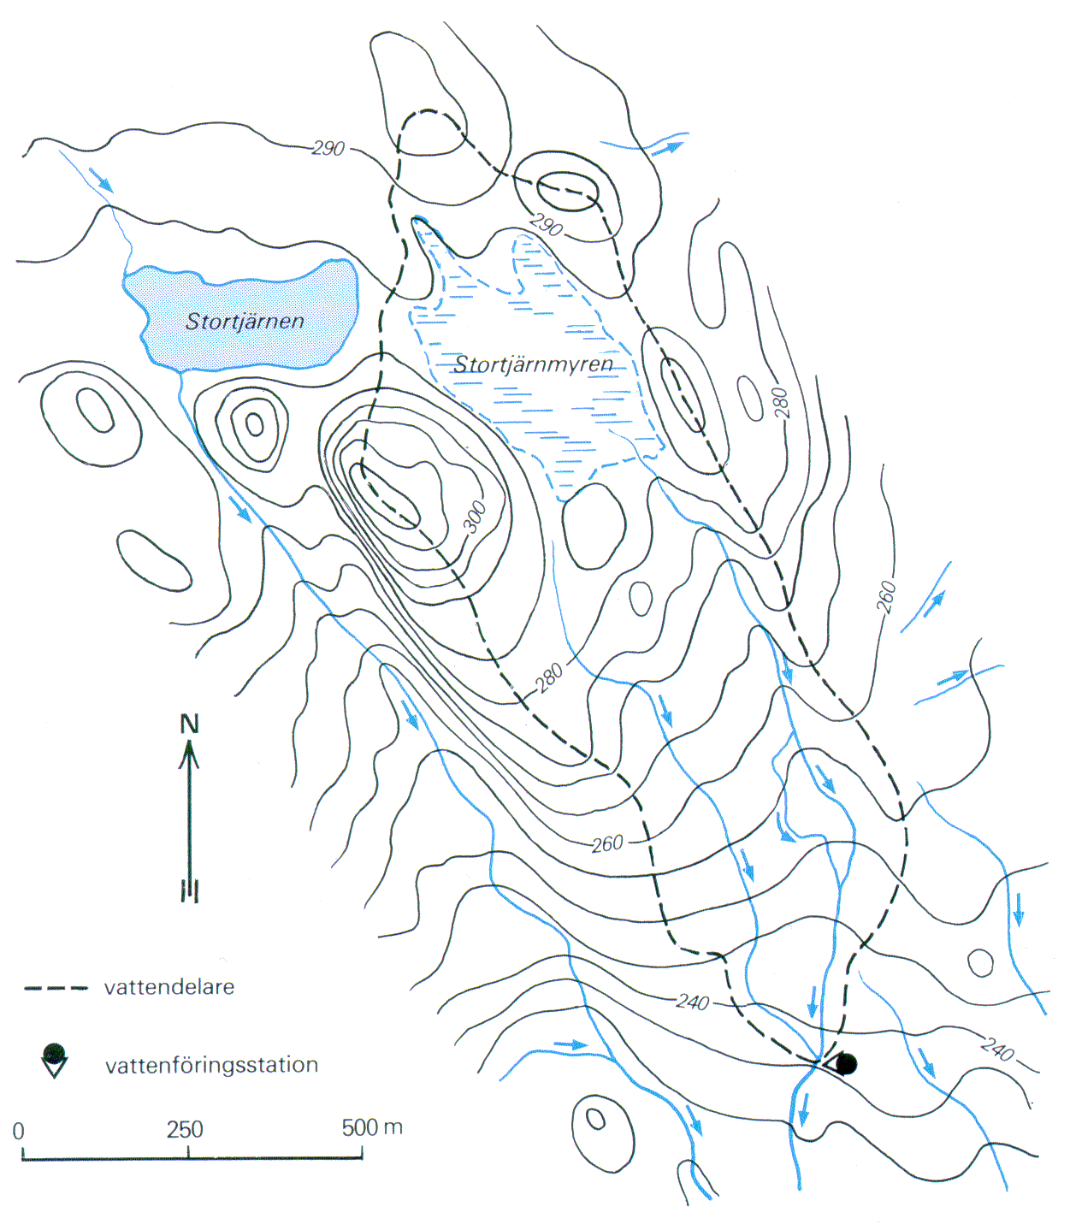
Svartberget catchment

Slide 4
Source:
Nominic Report on DOC character Nordtest Technical Report 479

